Slide 1
Geography of India and Planned Cities on the Indus
2.3 Notes

Slide 2
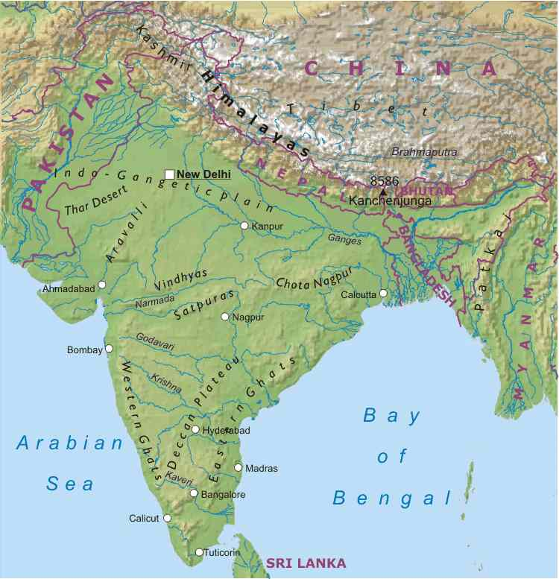
The Geography of the Indian Subcontinent
The landmass that includes India, Pakistan, and Bangladesh is called the Indian subcontinent
Mountains separate this region from rest of Asia
  Himalayan Mountains
  Hindu Kush Mountains
These mountains and Thar desert protected Indus Valley from invasion
A large, fertile plain formed between 2 rivers

Slide 3
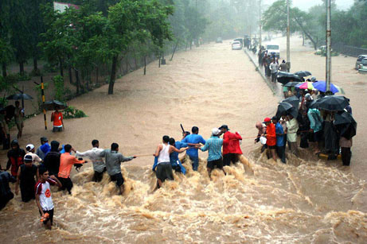
Major Rivers: The Indus and the Ganges
Civilization began along major rivers.
“India” derives from the Indus River.
Rivers present environmental challenges: Unpredictable!

Slide 4
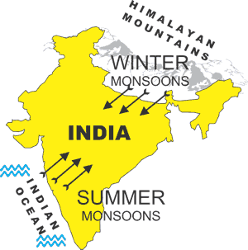
Monsoons Dominate India’s Climate
Monsoons are Winds.
90% of year’s rainfall
Timing is important:
Too Early = flooding
Too late = drought

Slide 5
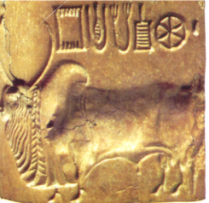
Early Civilizations
Around 2500 BC civilization developed in the Indus Valley
Early cities were well- planned
  Mohenjo Daro
  Harappa (many artifacts found here so Indus Valley Civ=Harappan Civ)
Little is known of these civilizations
  Unable to read ancient writings.

Slide 6
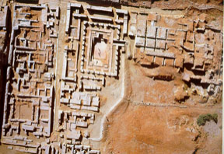
Clues from Archaeology
How do we know they were well planned cities?
  Grid system of streets
  Similar housing
  Indoor plumbing!
  Artifacts found point to a stable culture.

Slide 7
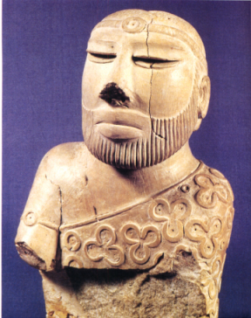
Harappan Culture
Relatively peaceful
Animals important
Religious artifacts reveal links to modern Hindu culture
Thriving trade with neighbors

Slide 8
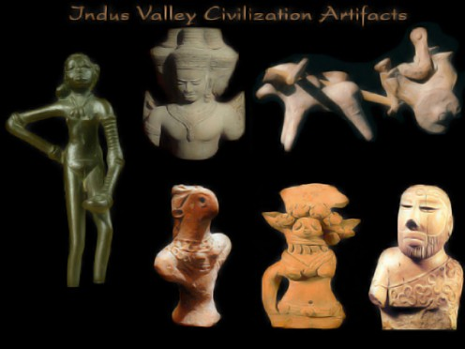
A Mysterious Decline
Over time, early cities were abandoned. Why?
Some Theories:
  Environmental issues (earthquake)
  Overuse of resources
  Warfare (Aryans)

