Slide 1

Ch. 3.1 The Indo - Europeans
A Semi-Nomadic People-
Invaded Europe, Asia, India
Mixed with other cultures
Objective: Describe the caste system. Is it a fair system? Why or why not?

Slide 2
Why might you leave your homeland?
Will you have to adopt the customs of the people living in a new land? How will you survive there?

Slide 3
Indo-European Migration
They lived in steppes region of Asia.
Left their homeland for various reasons.
Migration took place in waves.
Began adapting and mixed with new cultures.

Slide 4
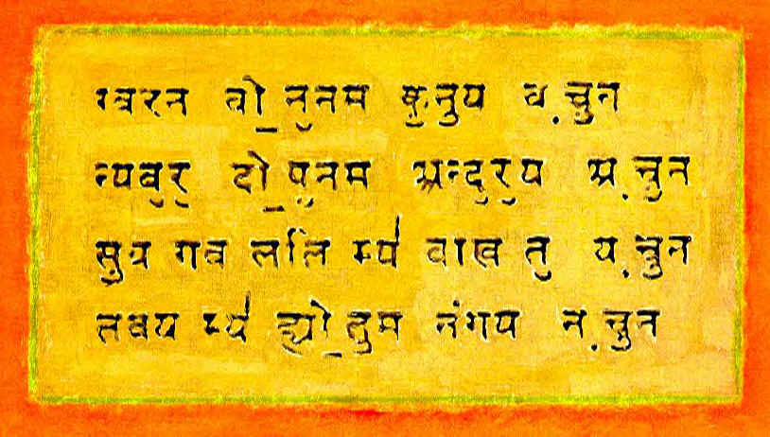
New Language Families Emerge
Aryans developed a written language called Sanskrit.
Many modern languages derived from Indo- European languages.
English, Spanish, Persian, German.

Slide 5

Aryans Invade India 1500 B.C.
Aryans used mountain passes to invade India.
Our source of knowledge of Aryans comes from The Vedas:
The Vedas are Aryan prayers, spells, rituals, used to worship their gods.

Slide 6
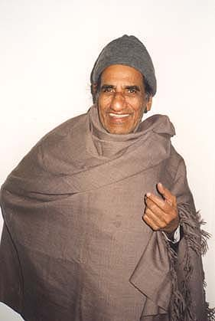
Aryans Begin the Caste System
Aryans considered themselves to be nobles. They divided people into classes.
A person’s class was based on varnas or “skin color.”
Indian people were called “dasas” = dark
Aryans kept separated from darker people.

Slide 7
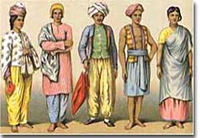
Three Main Aryan Classes
Main Social Classes:
Brahmins = Priests
Kshatrias =Warriors
Vaisyas = Landowners, traders
Shudras =Peasants
  They did the work Aryans refused to do.

Slide 8
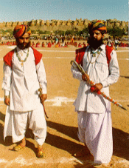
The Caste System
A person’s Caste determined their role in society.
One was born into a caste and stayed in that caste for life.
Followed strict rules for marriage, social systems.

Slide 9
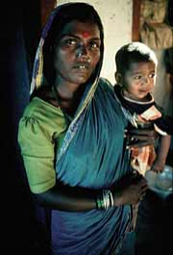
The Untouchables
These were the lowest people in society - Considered unclean, impure.
Not even part of the caste system.
Touching one could make one impure
Did lowest jobs.

Slide 10
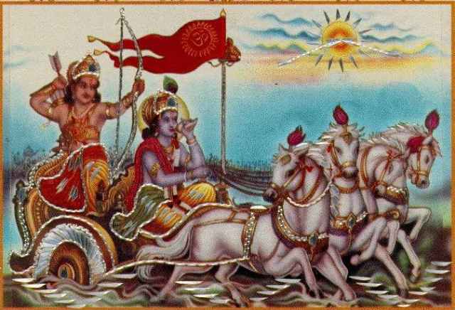
The Mahabharata
Great epic of Indian history.
  World’s longest poem
Struggles of Indians due to Aryan invasion.
  Struggles between two rival families.
Indian religious beliefs formed from upheaval.

Slide 11
Answer the Objective:
Objective: Describe the caste system. Is it a fair system? Why or why not?

