Slide 1
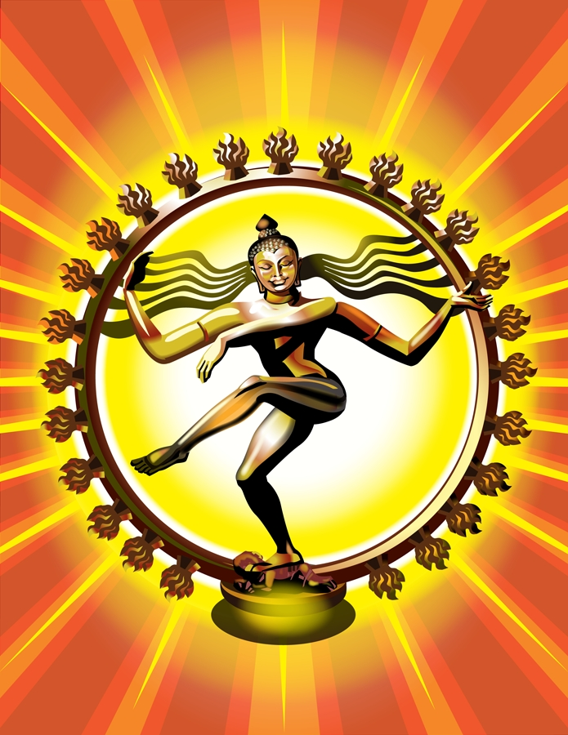
Ch. 3.2a Roots of Hinduism
Objective: Explain how the ideas of Hinduism helped to reinforce the caste system.

Slide 2
Aryan Invasions caused Change
First, Aryans and Indians followed their own religious beliefs.
Over time, beliefs began to blend together.
Thousands of gods were worshipped.
New ideas formed that are still followed today.

Slide 3
Hinduism Has No One Founder
Unlike some other religions of the world.
Like a large tree, Hindu beliefs developed over long periods of time.
It is difficult to organize Hindu beliefs into one major system.
No one authoritative scripture.
Symbol of Hinduism

Slide 4
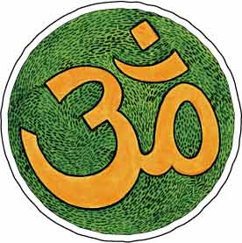
Origins and Beliefs
Hindus share a world view.
Religion is a way for one’s soul to be free of
illusions
disappointments
mistakes in people’s lives.

Slide 5
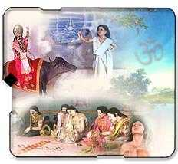
Hindu Teachers Studied the Vedas and asked Questions
What is morality ?
Is there eternal life ?
What is the soul ?
How can one escape suffering ?

Slide 6
The Upanishads: A Sacred Book
A collection of dialogues between Hindu teachers and students.
Exploring ways people could be liberated from desires and suffering in life.

Slide 7
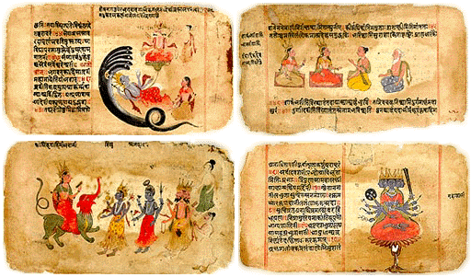
Hindu Ideas
Hindus believe all life is interconnected.
The Atman is the individual soul of a living being.
Brahman is the world soul.
Brahman contains and unites all atmans.

Slide 8
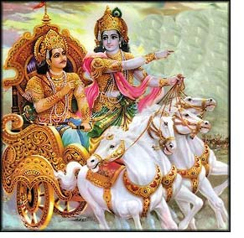
The Goal for Hindus
Understanding the relationship between the atman and Brahman.

Slide 9
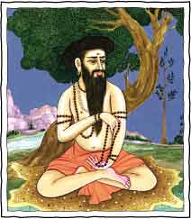
Hindus believe in Moksha
“A state of perfect understanding of all things.”
If one achieves moksha, one can gain release from life in this world.

Slide 10
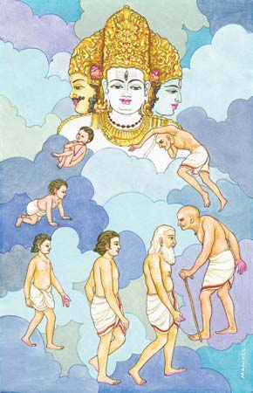
Hindus believe in Reincarnation
Achieving moksha usually takes more than one lifetime.
The soul may be reborn over and over (in many forms) until moksha is achieved.

Slide 11
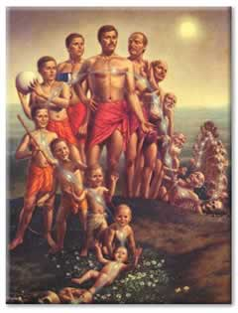
Karma: The Law of Cause and Effect
A person’s good or bad deeds follows them in each reincarnation.
“What you do today affects what you are tomorrow.”

Slide 12
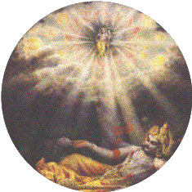
Three Paths to Moksha
Right thinking.
Right actions.
Right Religious devotion.
Any path may be followed !
Only men of the top 3 varnas
could expect to achieve moksha in their present life.

Slide 13
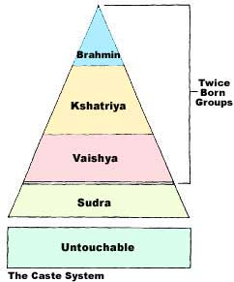
Ideas strengthened the Caste System
Good deeds in a past life earned good fortune in another life.
Bad deeds resulted in rebirth as a female, a lower caste or an untouchable.
Effect of Dharma:
To do one’s duty

Slide 14
Beliefs and Structures Dominated People’s Lives
They determined what people could eat and how one ate it.
Provided “rules” for how people dressed and whom people could associate with.

Slide 15
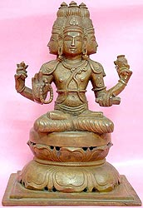
Hinduism Developed Further
Brahman is sometimes seen as having the personalities of three different deities:
Depict the three main parts of all human life:
Creation, preservation, and destruction.
Brahma - the creator

Slide 16
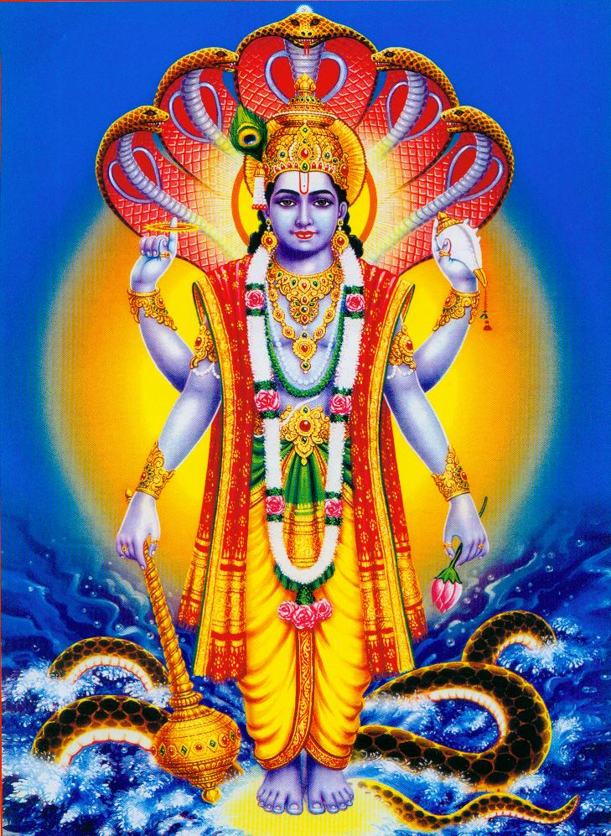
Vishnu The Protector
Maintains ultimate law and order.
Comes to earth in times of crisis as an avatar (human form).
9 Avatars have already appeared and the 10th has yet to come.
Krishna is the most well known avatar.

Slide 17
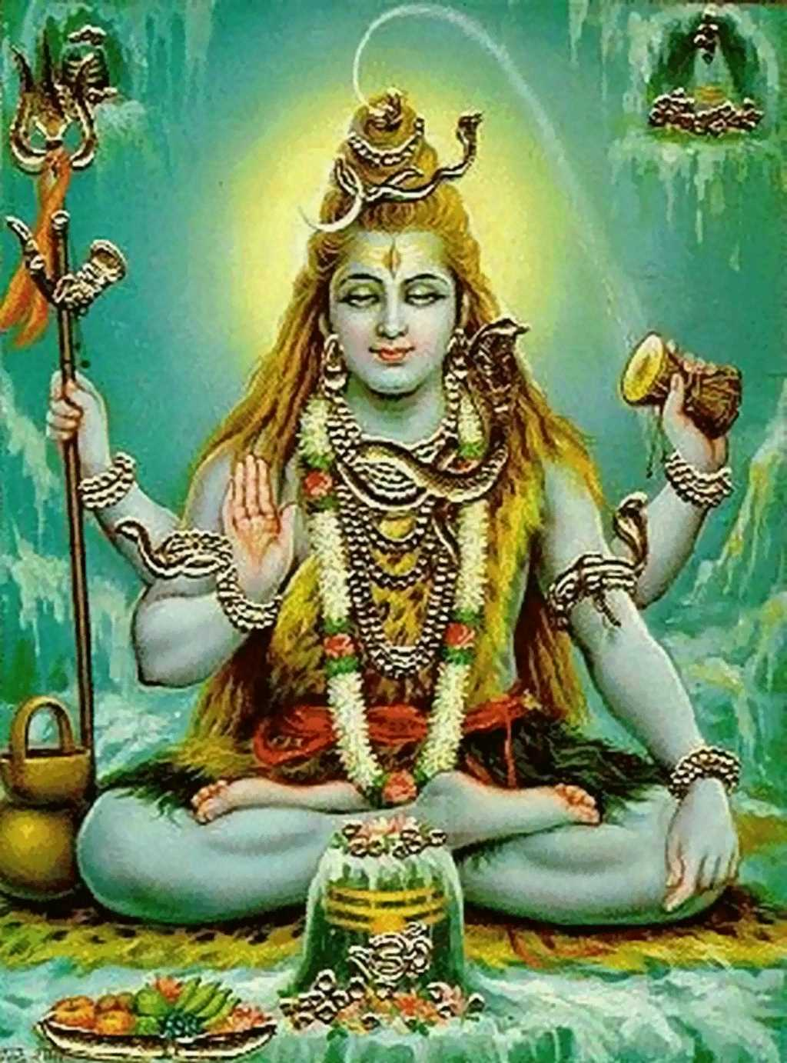
Shiva: The Destroyer
Shiva destroys evil and ignorance.
Allows for creation.
Shown meditating or dancing.

Slide 18
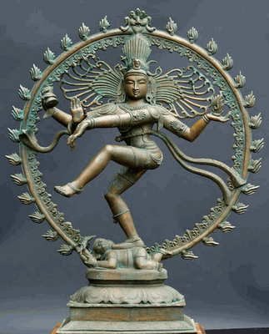

Slide 19
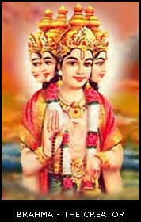
Hindu Deities
Often, deities are shown with multiple heads, hands or arms.
Allows them to hold objects which represent their powers, emotions and thoughts.
Often shown with a female consort. Hinduism values feminine power.

Slide 20
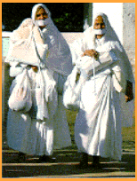
A New Religion Formed: Jainism
Based on the Hindu belief of “ahimsa” or non - violence.
Jains believe everything has a soul.
Nothing should be harmed.
Jains preach tolerance and work in jobs that do not harm any creature.

Slide 21
Lakshmi is the consort of Vishnu.
She is the deity of prosperity and wealth.

Slide 22
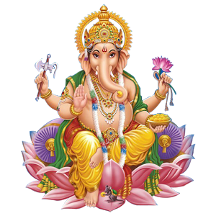
Ganesh: Deity of knowledge

Slide 23
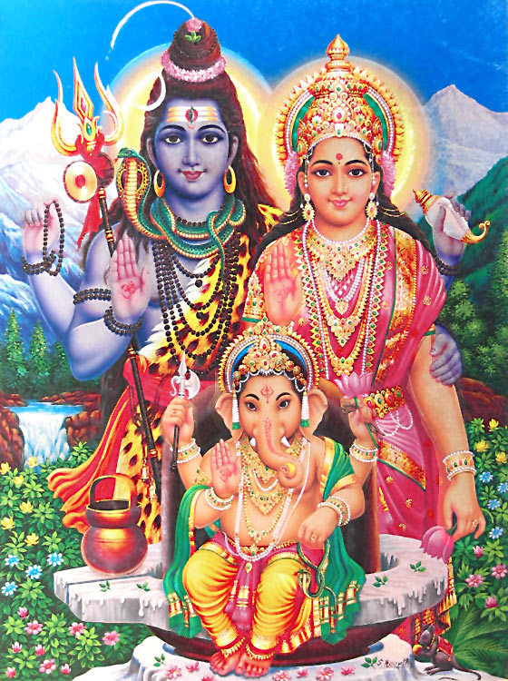
Parvati is the consort of Shiva.
They are shown with their son, Ganesh.

Slide 24
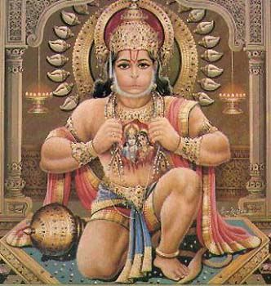
Hindu Deities
Rama and Sita with their loyal friend, Hanuman.
The ideal man and woman
Devotion and courage

Slide 25
Please answer the following questions:
How did the caste system begin?
How did the caste system influence the daily life of Hindus?
How did the belief in reincarnation support the caste system?

