Slide 1
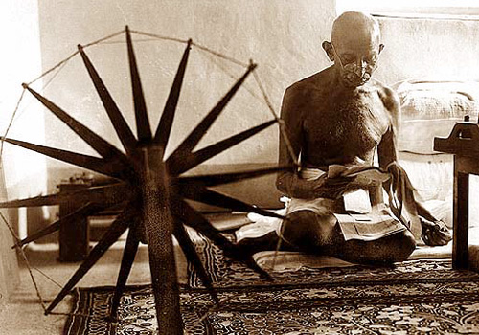
Ch. 30.4 Nationalism in India
Objective: Summarize how Gandhi used non-violent tactics to free India from British rule.

Slide 2
Seeds of Nationalism Grew
Upper class Indians attended British schools.
They began to apply western ideas of nationalism and democracy.
They resented 200 years of British rule and its effect in India.

Slide 3
Political Groups Formed
The Indian National Congress (Hindus).
The Muslim League.
Had intense differences based on their beliefs, but worked together toward a common goal.

Slide 4
WWI Brings Nationalist Interest
One million Indian men served in the British army.
Britain promised reforms leading to self government for India as a reward for military service.
After the war, those promises were not kept.

Slide 5
The Rowlatt Act
Radicals used violence to protest and show hatred of British rule.
A new law provided jailing for protesters for up to 2 years - without trial.

Slide 6
The Amritsar Massacre
10, 000 attended a rally in 1919 to pray, listen to speeches and fast.
Because public meetings were banned, British troops were ordered to open fire on the crowd.
400 were killed in ten minutes.

Slide 7
The World Was Watching
Soldiers went unpunished for deaths of innocent people.
Indian people were finally moved to become nationalist!
A strong sense of “India for Indians!”

Slide 8
A Leader Emerges
Mohandas K. Gandhi
Born in 1869, educated in England.
Practiced law in South Africa, where a large number of Indians lived.

Slide 9
South Africa: A British Colony
British had strong racist attitudes toward blacks.
Many Indians worked along with blacks on railroads, other projects.
There was little opportunity for improvement .

Slide 10
British Prejudice Greets Gandhi
Gandhi was ordered to sit in the train baggage car with other “people of color.”
When he refused, he was ejected from the train.
Gandhi began organizing against racism in South Africa .

Slide 11
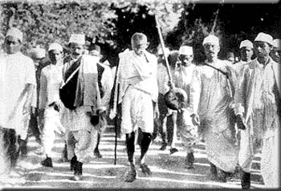
Gandhi Returns to India
He became the leader of India’s drive for independence from Britain.
Led protests against the government.

Slide 12
Civil Disobedience
Gandhi’s method for seeking change was “peaceful resistance.”
A non - violent means for making people’s voices heard.
He led strikes, boycotts, marches, fasting.
The “Mahatma” - Great Soul

Slide 13
No Retaliation
Gandhi led others by his example.
Even if beaten, told people not to retaliate with violence.
Gandhi spent 7 years in jail for his protests.

Slide 14
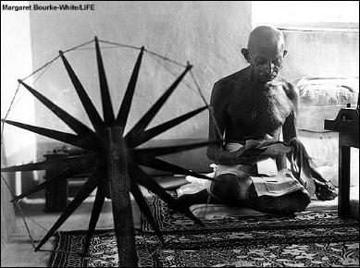
The Goal: Weaken British Political and Economic Power!
Gandhi asked people to follow a policy of non - cooperation.
Refuse to buy British goods, refuse to pay taxes, refuse to vote!
Urged people to weave their own cloth.
Effects were soon felt by British government.

Slide 15
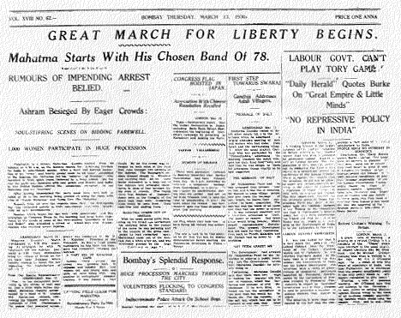
Key Events Led to Change
The Salt March:
Protest against a tax on salt by British.
Gandhi and followers walked 240 miles to collect sea water to make salt.
A protest at the salt works ended in extreme violence.

Slide 16
India is Granted Self-Rule
1935 the Government of India Act was passed.
Provided local self government and limited democratic elections.
Now, tensions between Hindus and Muslims heated up.
Muslims feared Hindu rule in a future independent India.
Gandhi Worried about
deep divisions in India.

