Slide 1
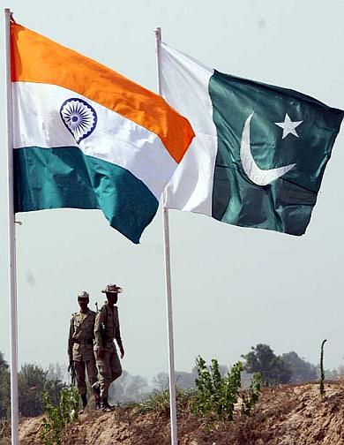
India Gains Independence
Ch. 34, Sec. 1
Objective: Describe the effects of independence in India.

Slide 2
The Drive to “Quit India”
In 1939, without consulting Indian officials, Britain committed Indian forces to fight in WWII.
The Congress Party began a campaign to drive the British out of India.

Slide 3
Colonists Shared Experiences
WWII brought soldiers from different colonies together.
Japanese victories in battles over European forces showed that colonial masters were not unbeatable.

Slide 4
Britain Rethinks Colonies
Costs of WWII were staggering to England.
Governing colonies far from home was difficult and expensive.
Questions arose about the morality of imperialism .

Slide 5
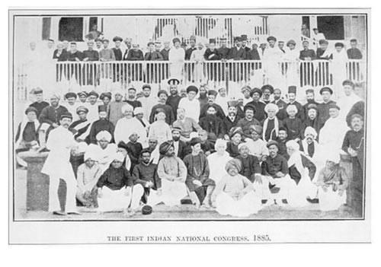
Political Problems
The Congress Party formed to represent all Indian people.
Members were heavily Hindu, but many were also Muslims.
Muslims believed Hindus looked out for their own interests at their expense.

Slide 6
Hindus and Muslims Divide
Muhammad Ali-Jinnah urged Muslims to resign from the Congress Party.
The British encouraged division between Hindus and Muslims.
If unified, their voices would be stronger against the government.
Gandhi worked tirelessly
To avoid separation.

Slide 7
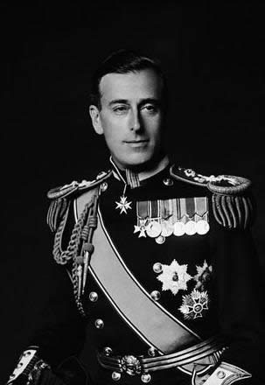
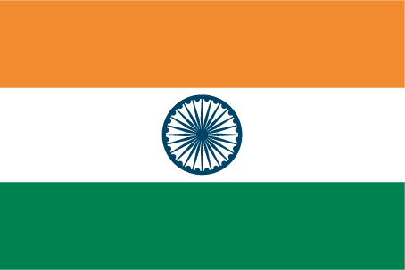
India Won Independence
In 1947 Britain gave India its freedom. Viceroy Mountbatten handed control over to India.
Religious hatred between Hindus and Muslims flared.

Slide 8
Partition of India
Violence between Hindus and Muslims reached a peak in 1946.
The idea of partition of India into two nations after independence became a reality.

Slide 9
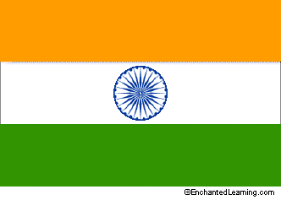
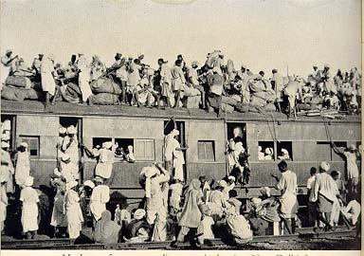
India is Split into Two
After independence, Muslims demanded separation from India.
A new nation called Pakistan was created.
1 Million die in violence as people were forced to move.

Slide 10
Partition Brought Major Problems
Hundreds of princes had to decide what nation they would join.
A nightmare to divide up all aspects of government for a new nation.

Slide 11
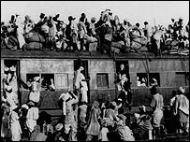
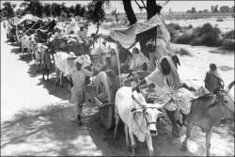
Minorities in a Hostile Nation
Millions of Hindus, Muslims and Sikhs found themselves living in the wrong nation!
10 million refugees moved place to place.
Violence left 1 million people dead.

Slide 12
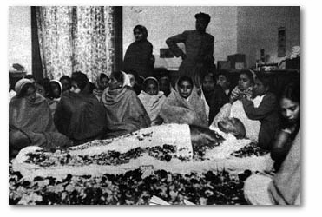
Gandhi is Assassinated
Jan. 30, 1948:
Preparing to speak in public gathering.
A Hindu extremist shot Gandhi. He was 78.
Hopes for peace in India died with him.

Slide 13
Death of the Mahatma
Gandhi was deeply hurt by the partition of India. He felt his life was a failure.
Millions attended Gandhi’s Funeral.
“An eye for an eye… and soon the world is blind…”

Slide 14
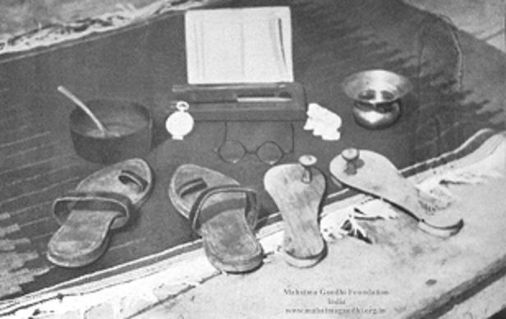
Gandhi’s Only Possessions
These items fit into a shoebox.
Great impact on the world. Non - violence as a means for change.

Slide 15
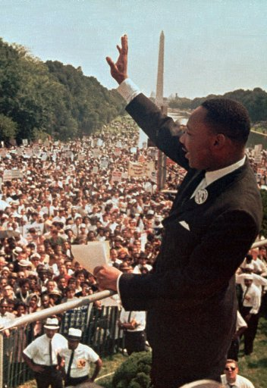
Gandhi’s Ideas Inspired Others
Martin Luther King,Jr. used Gandhi’s idea of civil disobedience .
To gain civil rights for African Americans in the U.S. during the 1950’s and 1960’s.

Slide 16
Nehru Leads India
Jawaharlal Nehru led India as its first prime minister.
He worked toward economic modernization.

Slide 17
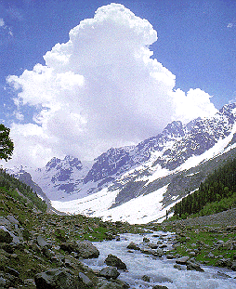
Kashmir: A New Crisis
Dispute over territory of Kashmir led to a series of violent wars.
Both nations claim right to rule in this area.
A 1949 U.N. peace treaty still remains but Kashmir is still disputed.

Slide 18
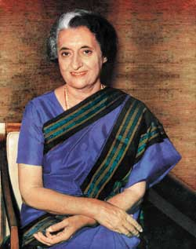
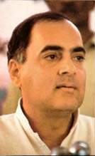
Violence Continues
1966: Nehru’s daughter, Indira Gandhi became prime minister of India.
Gandhi was killed by her Sikh bodyguards.
1991: Her son, Rajiv Gandhi was killed by terrorist bomb while running for prime minister.

Slide 19
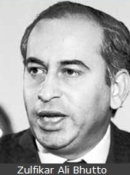
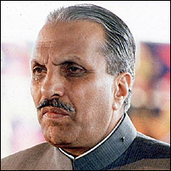
Pakistan’s Leaders Die Violently
1977-Prime Minister Ali Bhutto was deposed in a coup by General Zia.
Bhutto is hanged for ordering an opponent to be killed.
1988- General Zia Dies in strange plane crash.

Slide 20
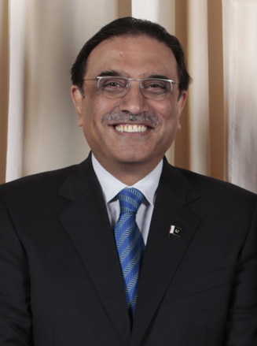
Politics Turn Deadly
February 2008:
Former Prime Minister Benazir Bhutto is killed while running against Musharraf.
Charges have been made of a murder cover-up.
Her husband was elected in her place.
Asif Ali Zardari

Slide 21
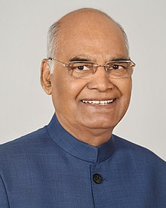
India Today
Over 1 billion people and climbing.
India is the world’s largest democracy.
Social issues :
The Caste system still holds in much of India, especially marriage and politics
India is a “sleeping giant” on the world’s economic stage.
President Ram Nath Kovind

Slide 22
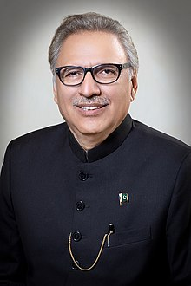
Pakistan Today
Led by President Arif Alvi
Current Issues
Terrorism
Poverty
Education

