Slide 1
Apartheid
35.2 Notes

Slide 2
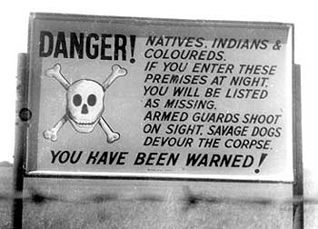

Slide 3
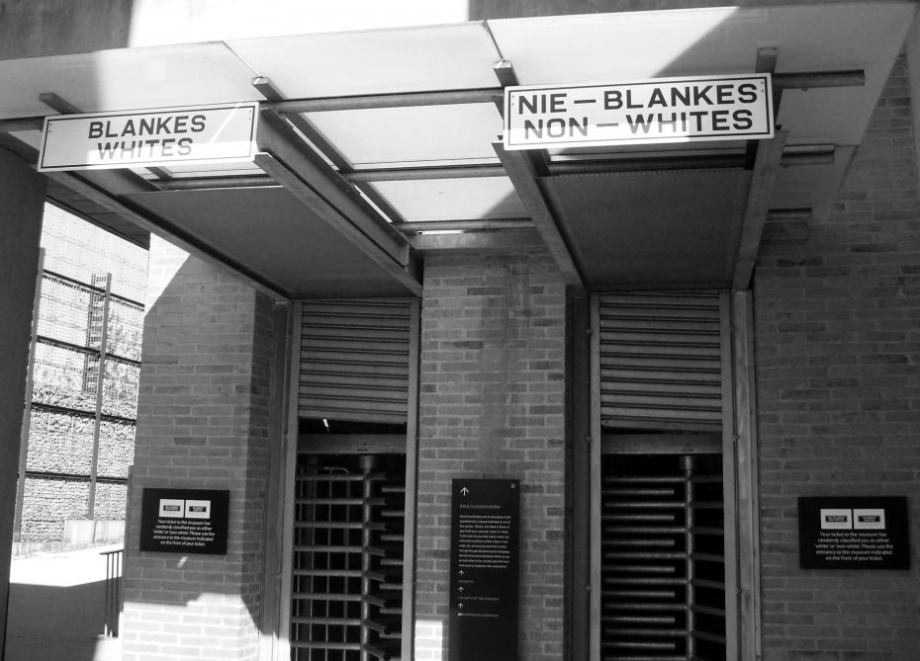

Slide 4
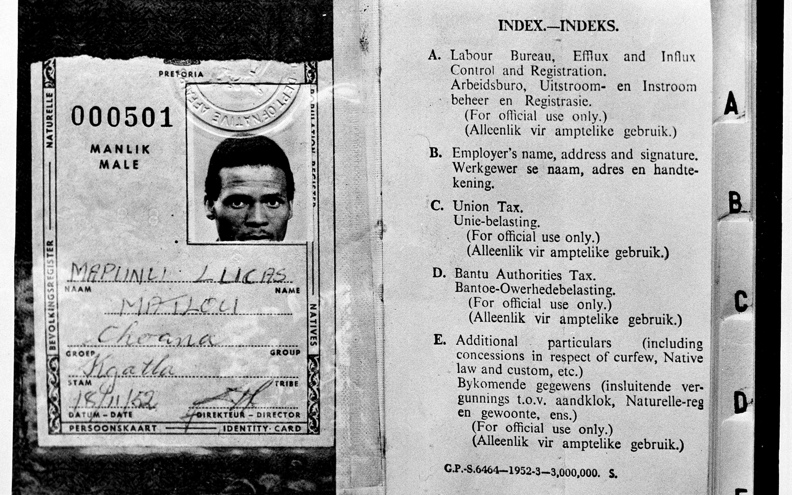

Slide 5
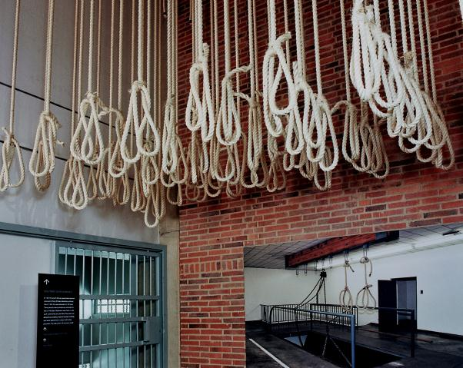
Notes:
Apartheid Museum in Johannesburg, South Africa; 131 nooses, representative of the 131 government opponents who were executed under antiterrorism laws

Slide 6
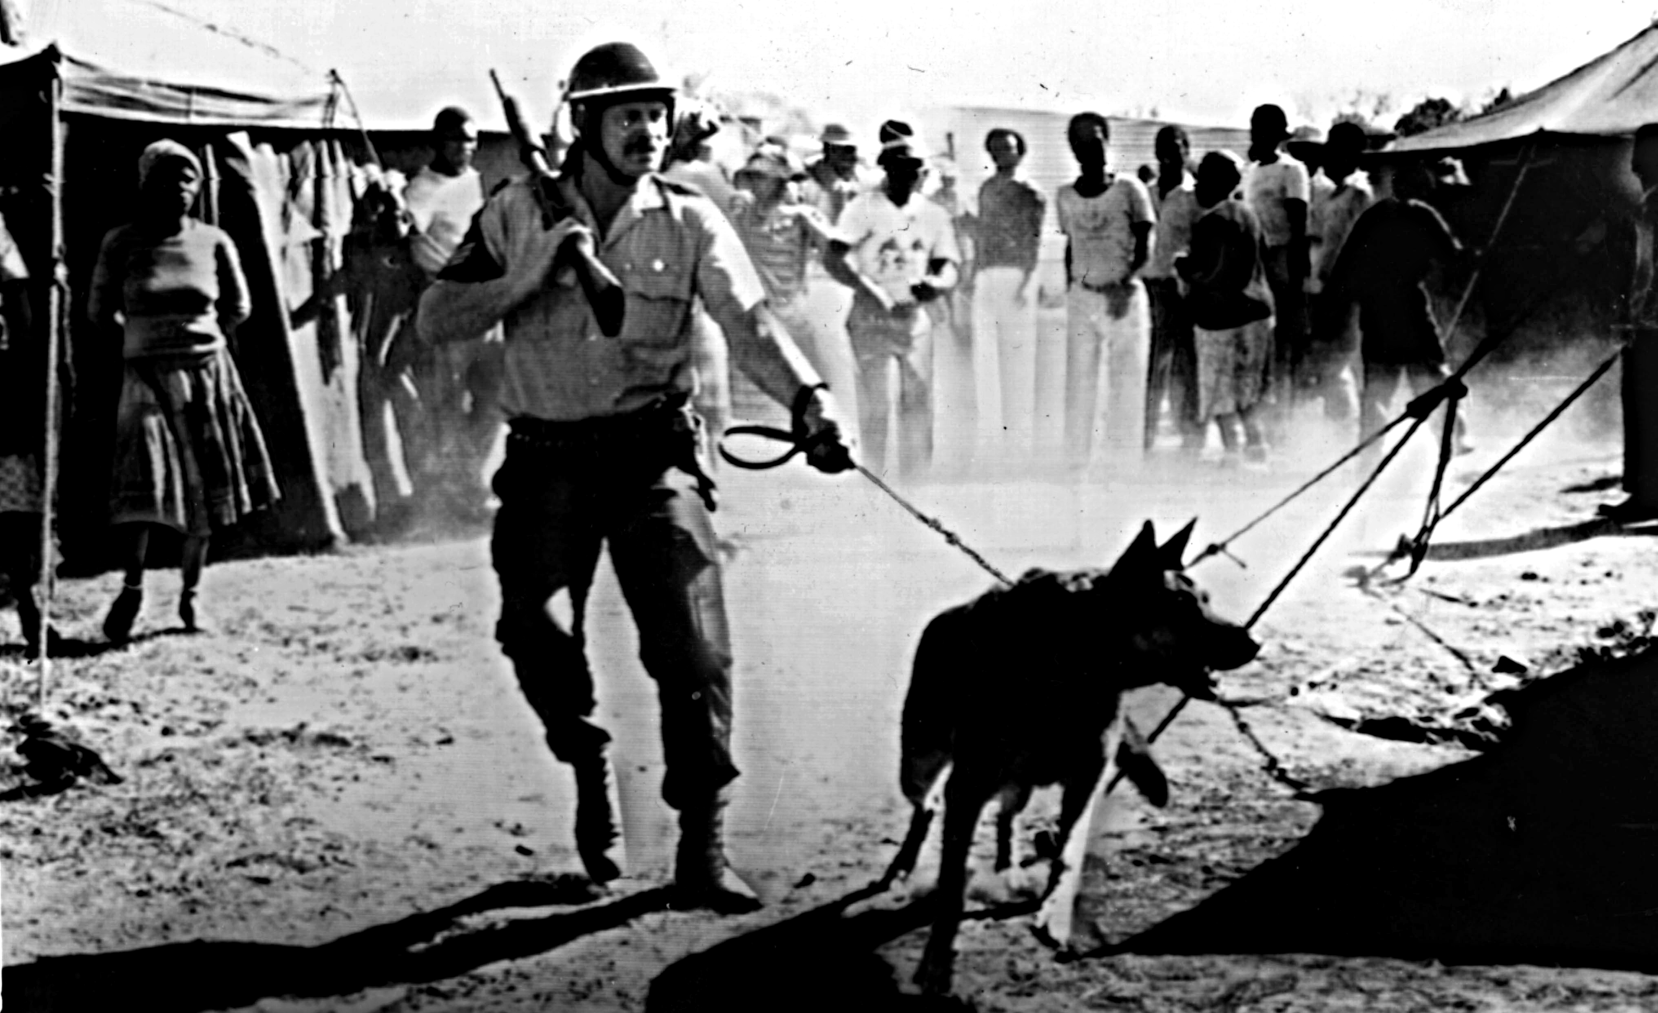

Slide 7
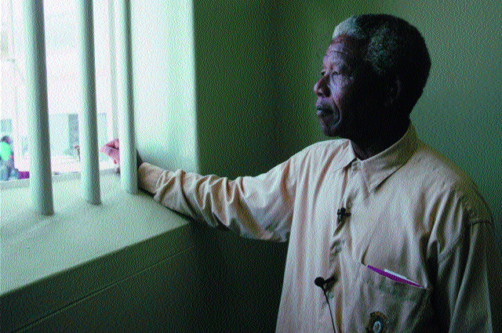
Notes:
Nelson Mandela-27 years in prison; died Dec 2013

