Slide 1
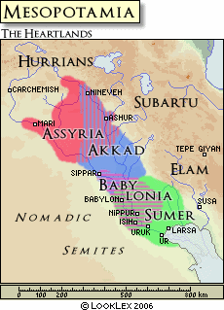
City-States in Mesopotamia
2.1 Notes

Slide 2
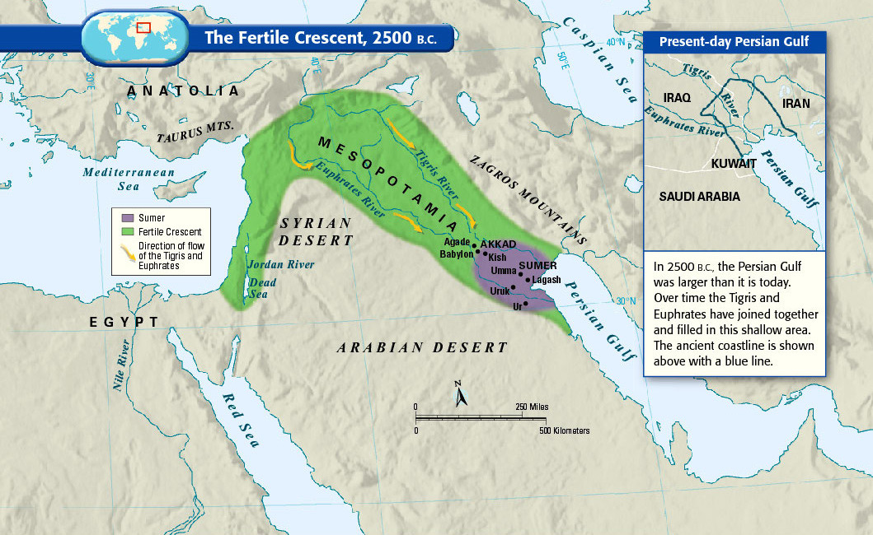
-Civilization began around 4500 BC when people settled in Mesopotamia
-3300 BC Sumerians arrived

Slide 3
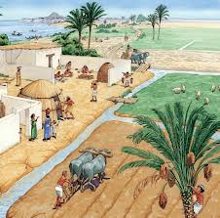
Environmental Challenges
Problem 1: Unpredictable flooding and droughts
Solution: irrigation ditches

Slide 4
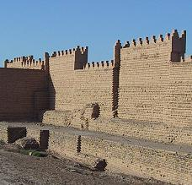
Problem 2: No natural barriers
Solution: built city walls
Notes:
City walls of Babylon

Slide 5
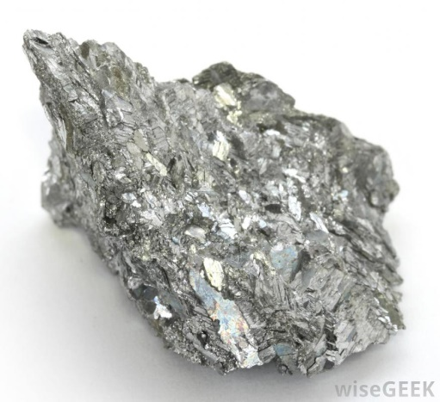
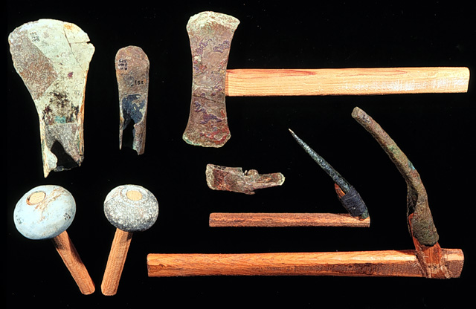
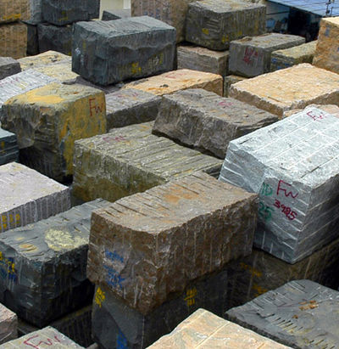
Problem 3: Limited natural resources
Solution: trade with neighbors
Metal, Wood, Stone
Cloth, Grain, Tools for…

Slide 6
Solving Problems Through Organization
Those solutions required: organization, cooperation, leadership, and laws
Laws and Leaders
Organized government
Civilization

Slide 7
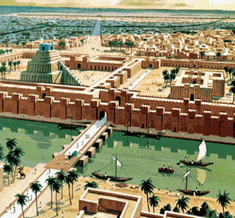
Sumerians Create City-States
5 key characteristics were:
advanced cities
specialized workers
complex institutions
record keeping
improved technology
Each city and surrounding land formed a city-state, functioned like independent countries

Slide 8
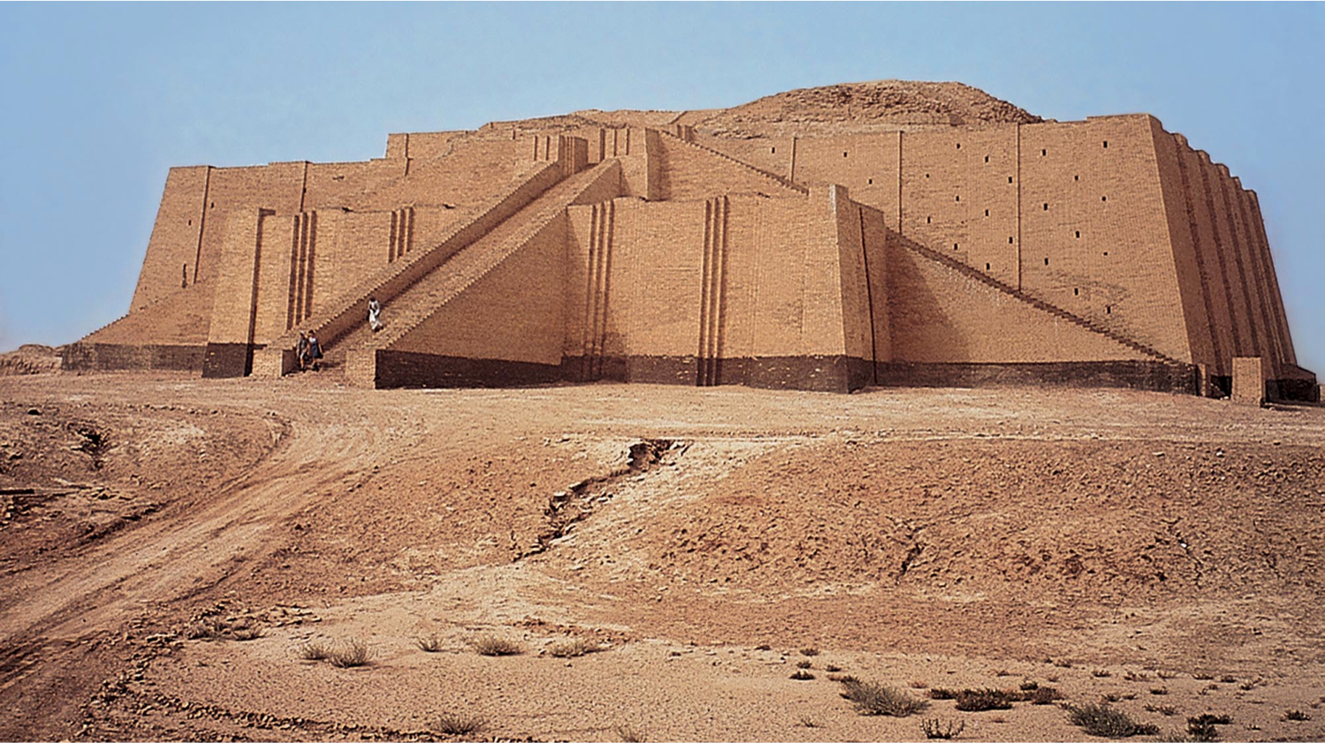
Center of all Sumerian cities was the ziggurat
Notes:
Ziggurat at Ur in Iraq

Slide 9
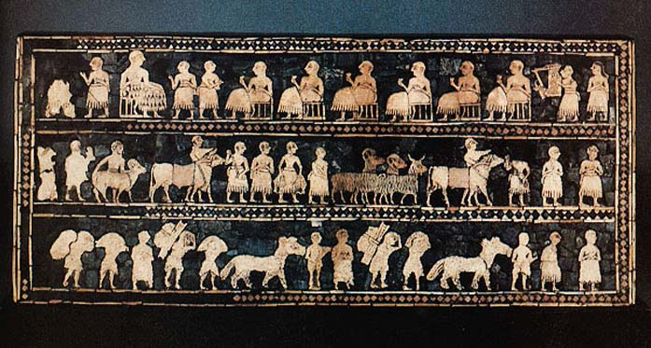
Priests and Rulers Share Control
Sumer’s earliest gov’ts were controlled by priests
Eventually military leaders became full time rulers, passed power on to sons
this series of rulers from a single family is called a dynasty

Slide 10
Sumerian Culture
Kings, Landholders, Priests
Wealthy Merchants
Ordinary People
Slaves
Polytheism:
belief in more than one God
Social Classes
Women had many rights
Science and Technology
Inventions: wheel, sail, plow, used bronze
Number system based off arithmetic and geometry
Arches, columns, ramps, and pyramids
System of Writing: cuneiform

Slide 11
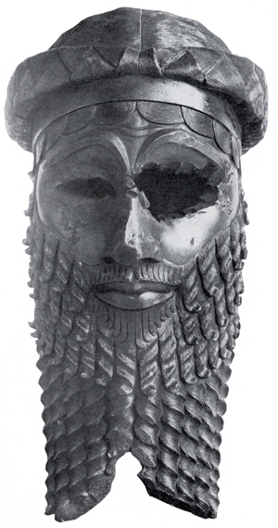
Sumer Falls, Akkad Rises
2350 BC conqueror named Sargon defeated city-states of Sumer=Akkadians
Sargon created the world’s first empire: brings together several groups of people under the control of one ruler
dynasty lasted 200 yrs
Notes:
Found in 1931. Made of Bronze

Slide 12
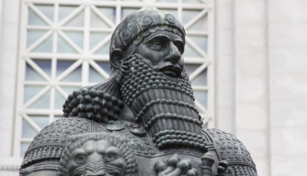
Babylonian Empire
2000 BC nomadic warriors invaded Mesopotamia, est capital at Babylon
Babylonian Empire reached height under reign of Hammurabi, 1792-1750BC
most enduring legacy is his code of laws

