Slide 1
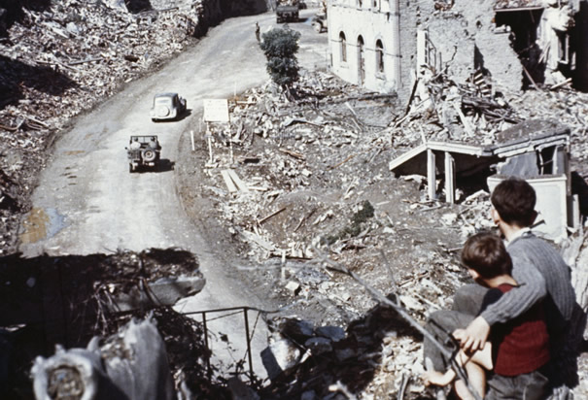
Europe and Japan in Ruins
32.5 Notes

Slide 2
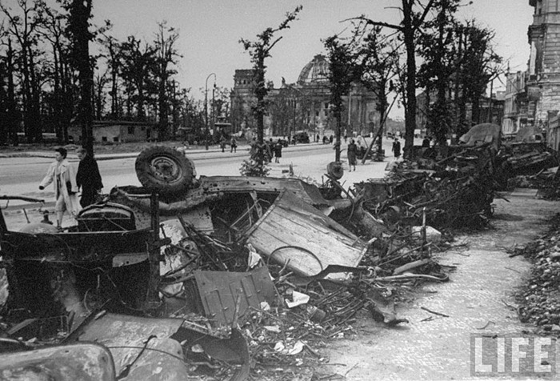
Devastation in Europe
After 6 yrs WWII ends:
60 million dead
50 million homeless/uprooted
billions in damage
Many European cities ruined
Warsaw: 1939 had population of 1.3 million-in 1945 only 153,000 remained
95% of central area of Berlin was destroyed

Slide 3
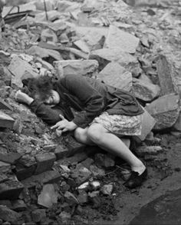
Europe’s countryside was ruined, transportation systems as well, so famine and disease spread

Slide 4
Nuremberg Trials
Nuremberg Trials: An International Military Tribunal put Nazi war criminals on trial in Nuremberg, Germany
22 Nazi leaders charged with waging a war of aggression, crimes against humanity, and murder of 11 million people (Holocaust)

Slide 5
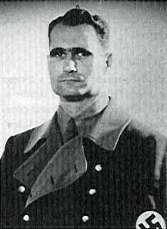
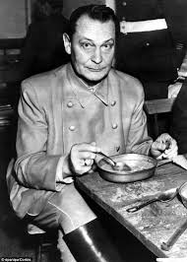
Twelve Nazis sentenced to death-only one expressed remorse
Established idea that you are responsible for your actions during wartime!
Helped start International Laws, tribunals for future genocides
Hermann Goring
Rudolf Hess

Slide 7
Results of WWII
Creation of the United Nations
Creation of Israel
New government in Japan
Standoff between the US and Soviet Union……Cold War!

