Slide 1
Ghana
By: Thalia Kennedy, Ashley Sampang, and Trinity Santiago

Slide 2
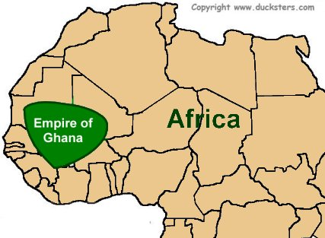
Empire of Ghana ; A.D. 700-1076

Slide 3
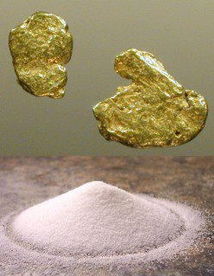
Gold-Salt Trade
Two most important trade items were gold and salt
Gold came from forest region between Niger and Senegal rivers
Miners dug gold from deep shafts or sifted it from fast-moving streams
West African savannas and forests lacked salt
Sahara contained deposits of salt
African traders bought gold north of forest regions
Royal officials enforced fair business according to law

Slide 4
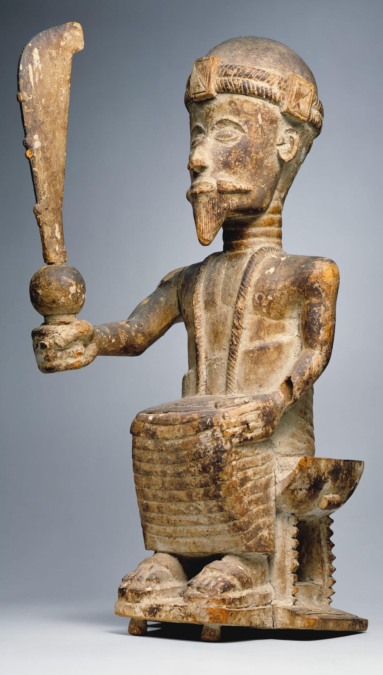
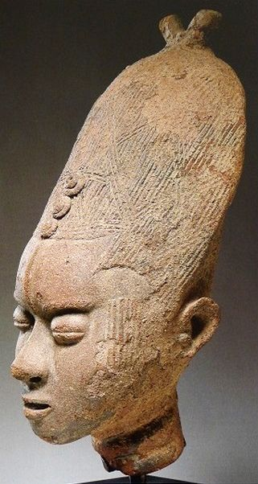
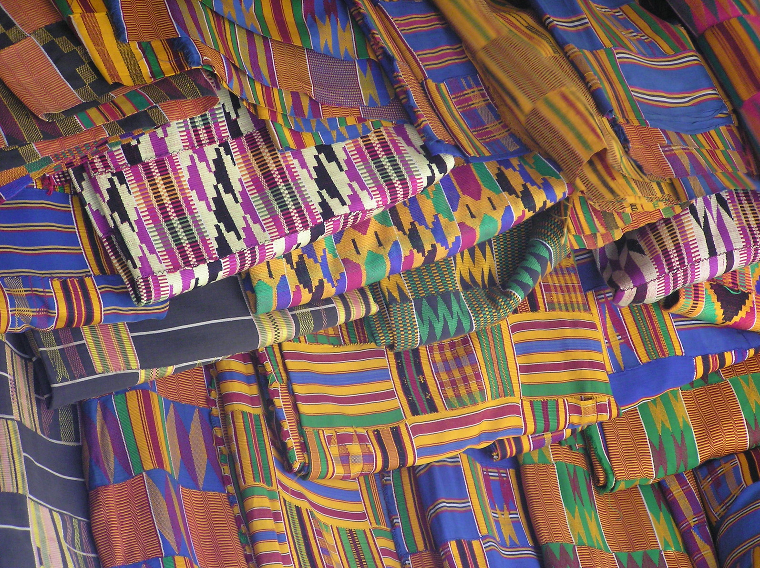
Art From Ghana
Memorial head sculpted by the people of Ghana
A woven garment called kente cloth
A statue of this king was made to show his authority

Slide 5
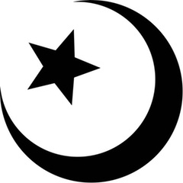
Key Ideas
Ruler Converted to Islam
This is the reason there is a large population of Muslims in Western Africa
Majority of population refused to convert
Believed in animism - belief that spirits living in animals, plants, and natural forces play an important role in daily life
Ghana
‘War chief’
Kingdom fell and never gained power again
1076 - Muslim Almoravids disrupted the gold salt trade

Slide 6
The Four W’s
Who:
The Rulers of the kingdom, referred to as ‘Ghana’ by the Soninke people
What:
The kingdom of Ghana grew rich
When:
A.D. 700 to A.D. 1000
Where:
Western Africa, present day Algeria, Niger, and Mali
How:
Rulers became rich through taxing goods traded through Ghana Territory.

