Slide 1
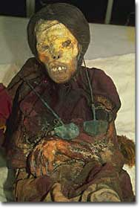
Inca Civilization
When? AD 1400-1533
When? AD 1400-1533

Slide 2
Quick Think Pair Share
Is unity important for a civilization? Why/Why not?
How does a civilization create unity? Think of examples in the US

Slide 3
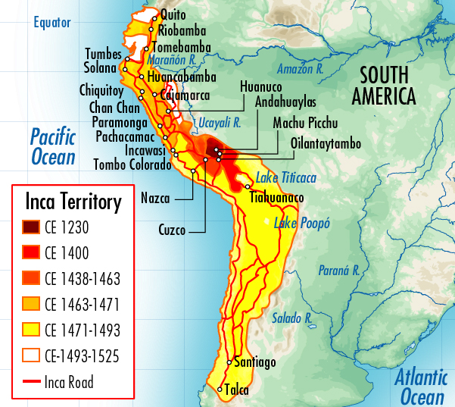
Incan Beginnings
Where? Valley of Cuzco (South America)
Largest empire in the Americas
UNITY!

Slide 4
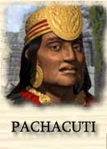
Pachacuti Builds an Empire
1438 new leader Pachacuti took over, grew empire
1500: empire stretched 2,500 miles, 16 million people
How?
diplomacy
military force

Slide 5
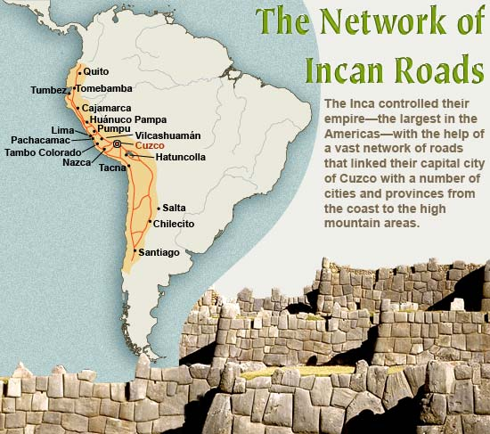
Incan Government Creates Unity
Bureaucracy
official language
road system
economic system

Slide 6
Incan Government
Social system- ayllu: extended family group
Gov’t demanded tribute in form of labor
mita: required people to work for state a certain number of days a year
Early socialism or modern welfare state

Slide 7
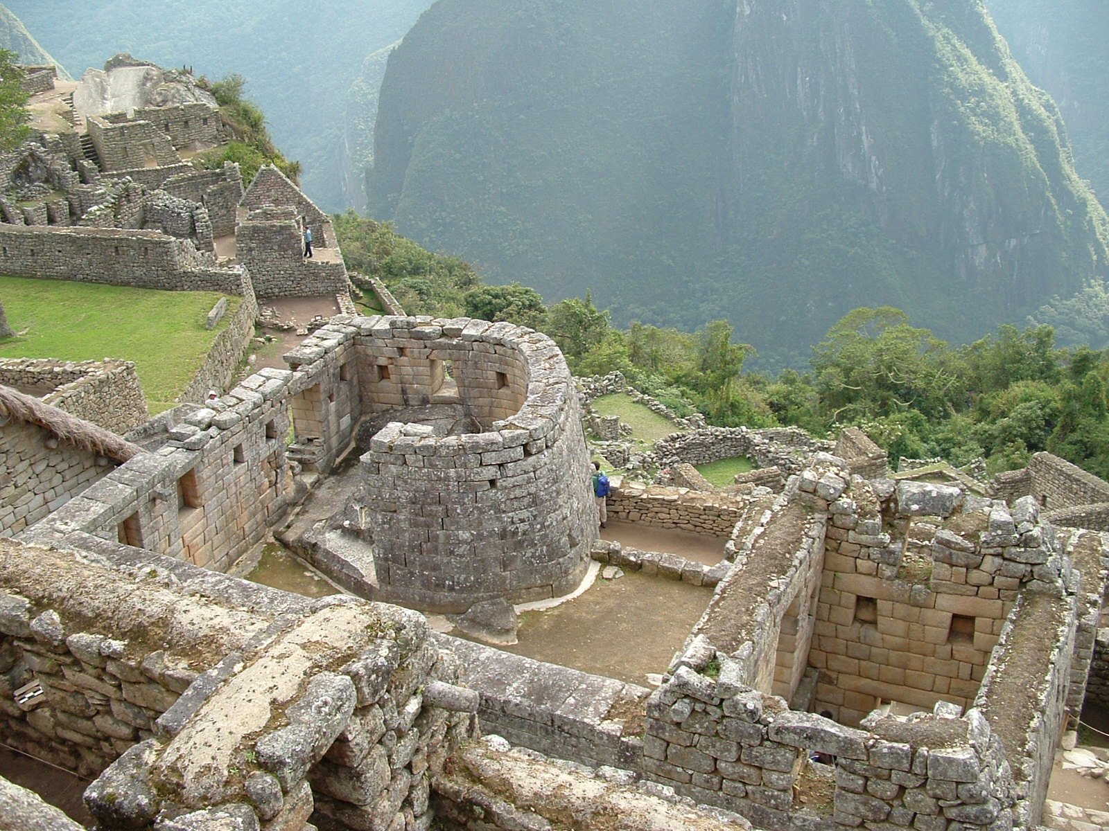

Slide 8
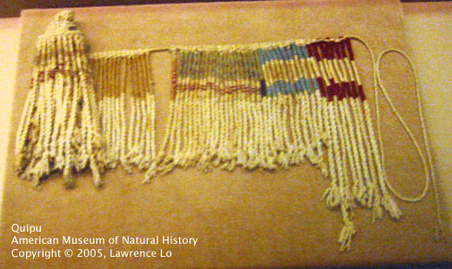
Government Record -Keeping
No written writing system
Quipu: set of knotted strings that could be used to record data; accounting device
Elaborate calendar for religious purposes

Slide 9
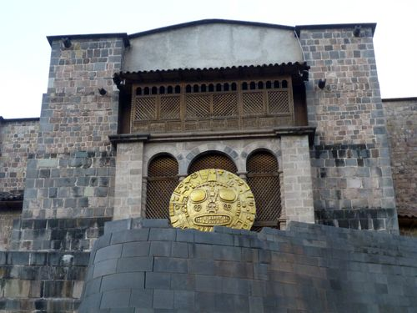
Religion Supports the State
Religion helped reinforce power of state
Ruler descended from Sun God, Inti
Temple of the Sun in Cuzco most sacred

Slide 10
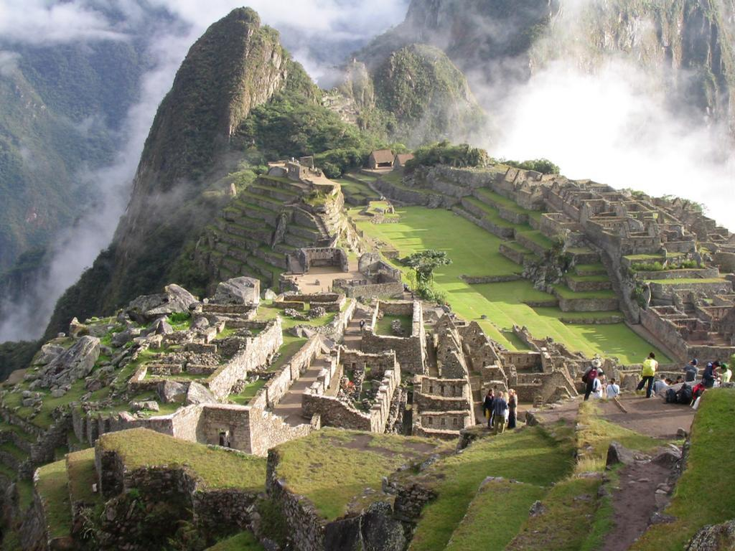

Slide 11
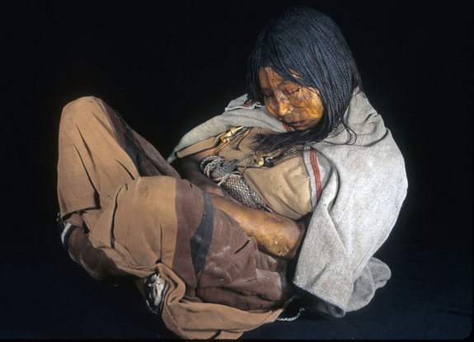
The Maiden

Slide 12
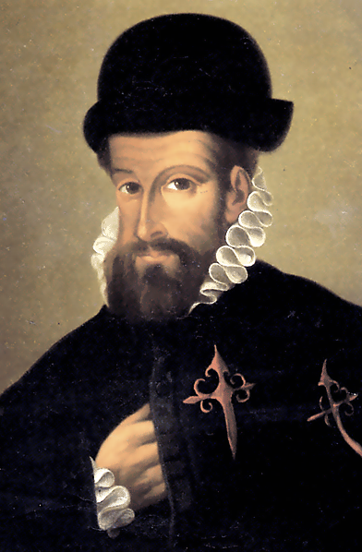
Decline of the Empire
Early 1500s leader died, civil war between heirs
1533 Spaniard Francisco Pizarro conquered the Incas

