Slide 1
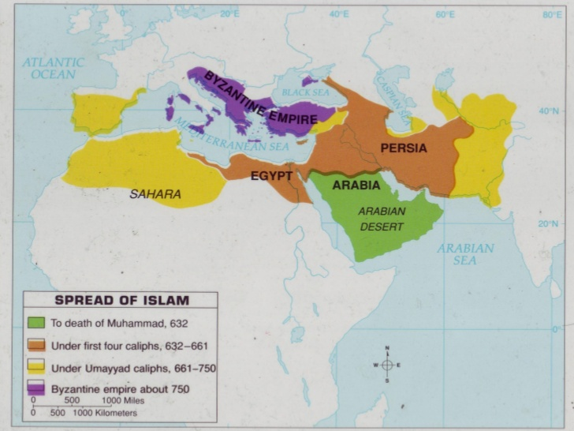
Islam Expands
10.2 Notes

Slide 2
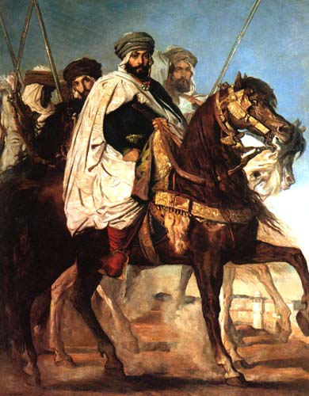
Muhammad’s Successors Spread Islam
Abu-Bakr succeeded Muhammad
632 became first caliph: ruler
Abu-Bakr invoked jihad, meaning armed struggle against unbelievers
This justified expanding Islam
By 634 Muslim state controlled all of Arabia

Slide 3
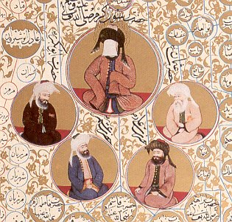
“Rightly Guided” Caliphs
Abu-Bakr, Umar, Uthman, and Ali=first four caliphs
They used Muhammad’s example plus Qur’an so called “Rightly Guided” caliphs
By 750 Muslim Empire stretched 6,000 miles

Slide 4
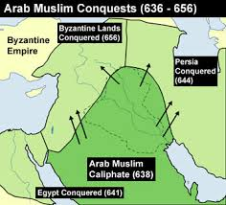
Reasons for Success
Successful due to…
1) well-disciplined armies and commanders
2) weakness of Byzantine and Sassanid (Persian) Empires
3) Treatment of conquered peoples
No forced conversions
Poll tax

Slide 5
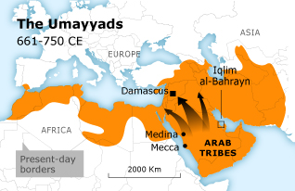
Internal Conflict Creates a Crisis
Muslim community had issues maintaining a unified rule
Uthman and Ali both assassinated
The Umayyad family came to power next
moved Muslim capital to Damascus
Umayyads also abandoned simple life of previous caliphs and surrounded themselves w/ wealth
this led to a fundamental division in the Muslim community

Slide 6
Sunni-Shi’a Split
A split occurred over the view of the caliph
group called Shi’a, or “party” of Ali, believe caliph needs to be a descendant of Ali; members called Shi’ites
Sunni, meaning followers of Muhammad’s example, is other group; they believe all Muslim rulers should follow Sunna
Another group, the Sufi, rejected the luxurious life of the Umayyads and pursued life of poverty

Slide 7
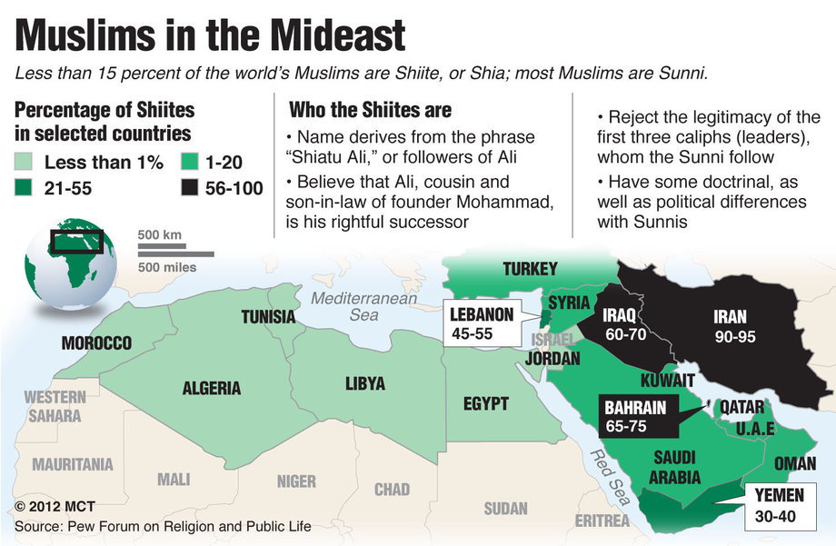

Slide 8
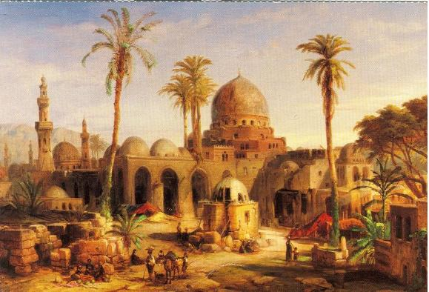
The Abbasid Caliphate (750-1258)
750 Umayyads replaced by the Abbasids
762: Moved capital to Baghdad
Location gave caliph access to trade and information
Developed strong
bureaucracy to
manage huge
empire

Slide 9
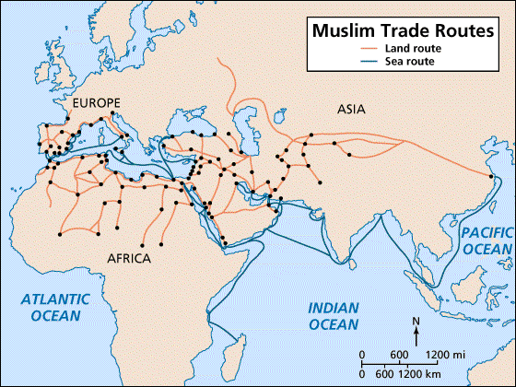
Muslims Trade Network
Muslim Empire well connected to trade routes
By water:
Mediterranean Sea and Indian Ocean
By land:
Silk Road to Asia
routes to Europe and
Africa
To encourage trade
Muslim merchants
set up banks throughout
empire
Offered letter of credit
(sakks=checks)

