Slide 1
Muslim Culture and the Ottoman Empire
10.3 and 18.1 Notes

Slide 2
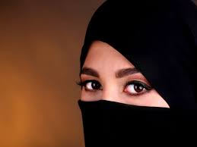
The Role of Women
Qur’an states women need to be obedient to men
Also, equal
Shari’a=specific legal rights
Responsibilities depended on income

Slide 3
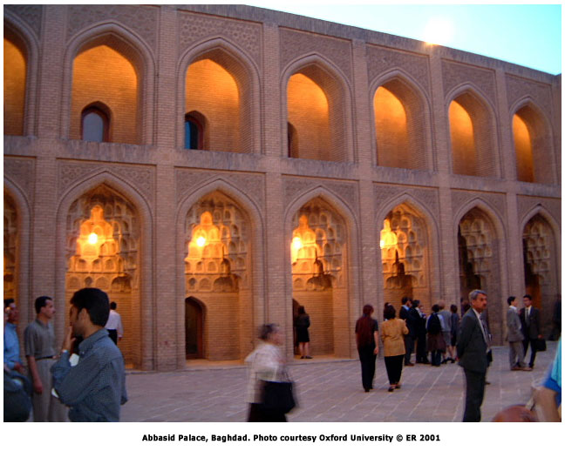
The Golden Age of Islam (Abbasids)
Translated Greek and Roman into Arabic
Mathematical and Scientific Discoveries
Astronomy

Slide 4
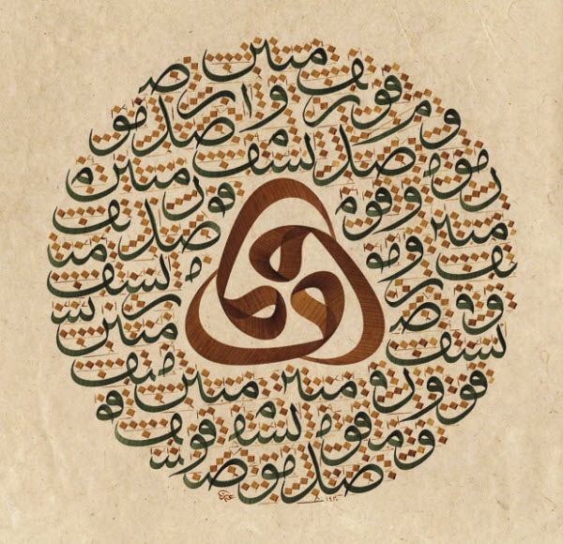
Muslim Literature and Art
The Thousand and One Nights
Only Allah can create life=discouraged images
Calligraphy: art of beautiful handwriting
Architecture: cultural blending

Slide 5
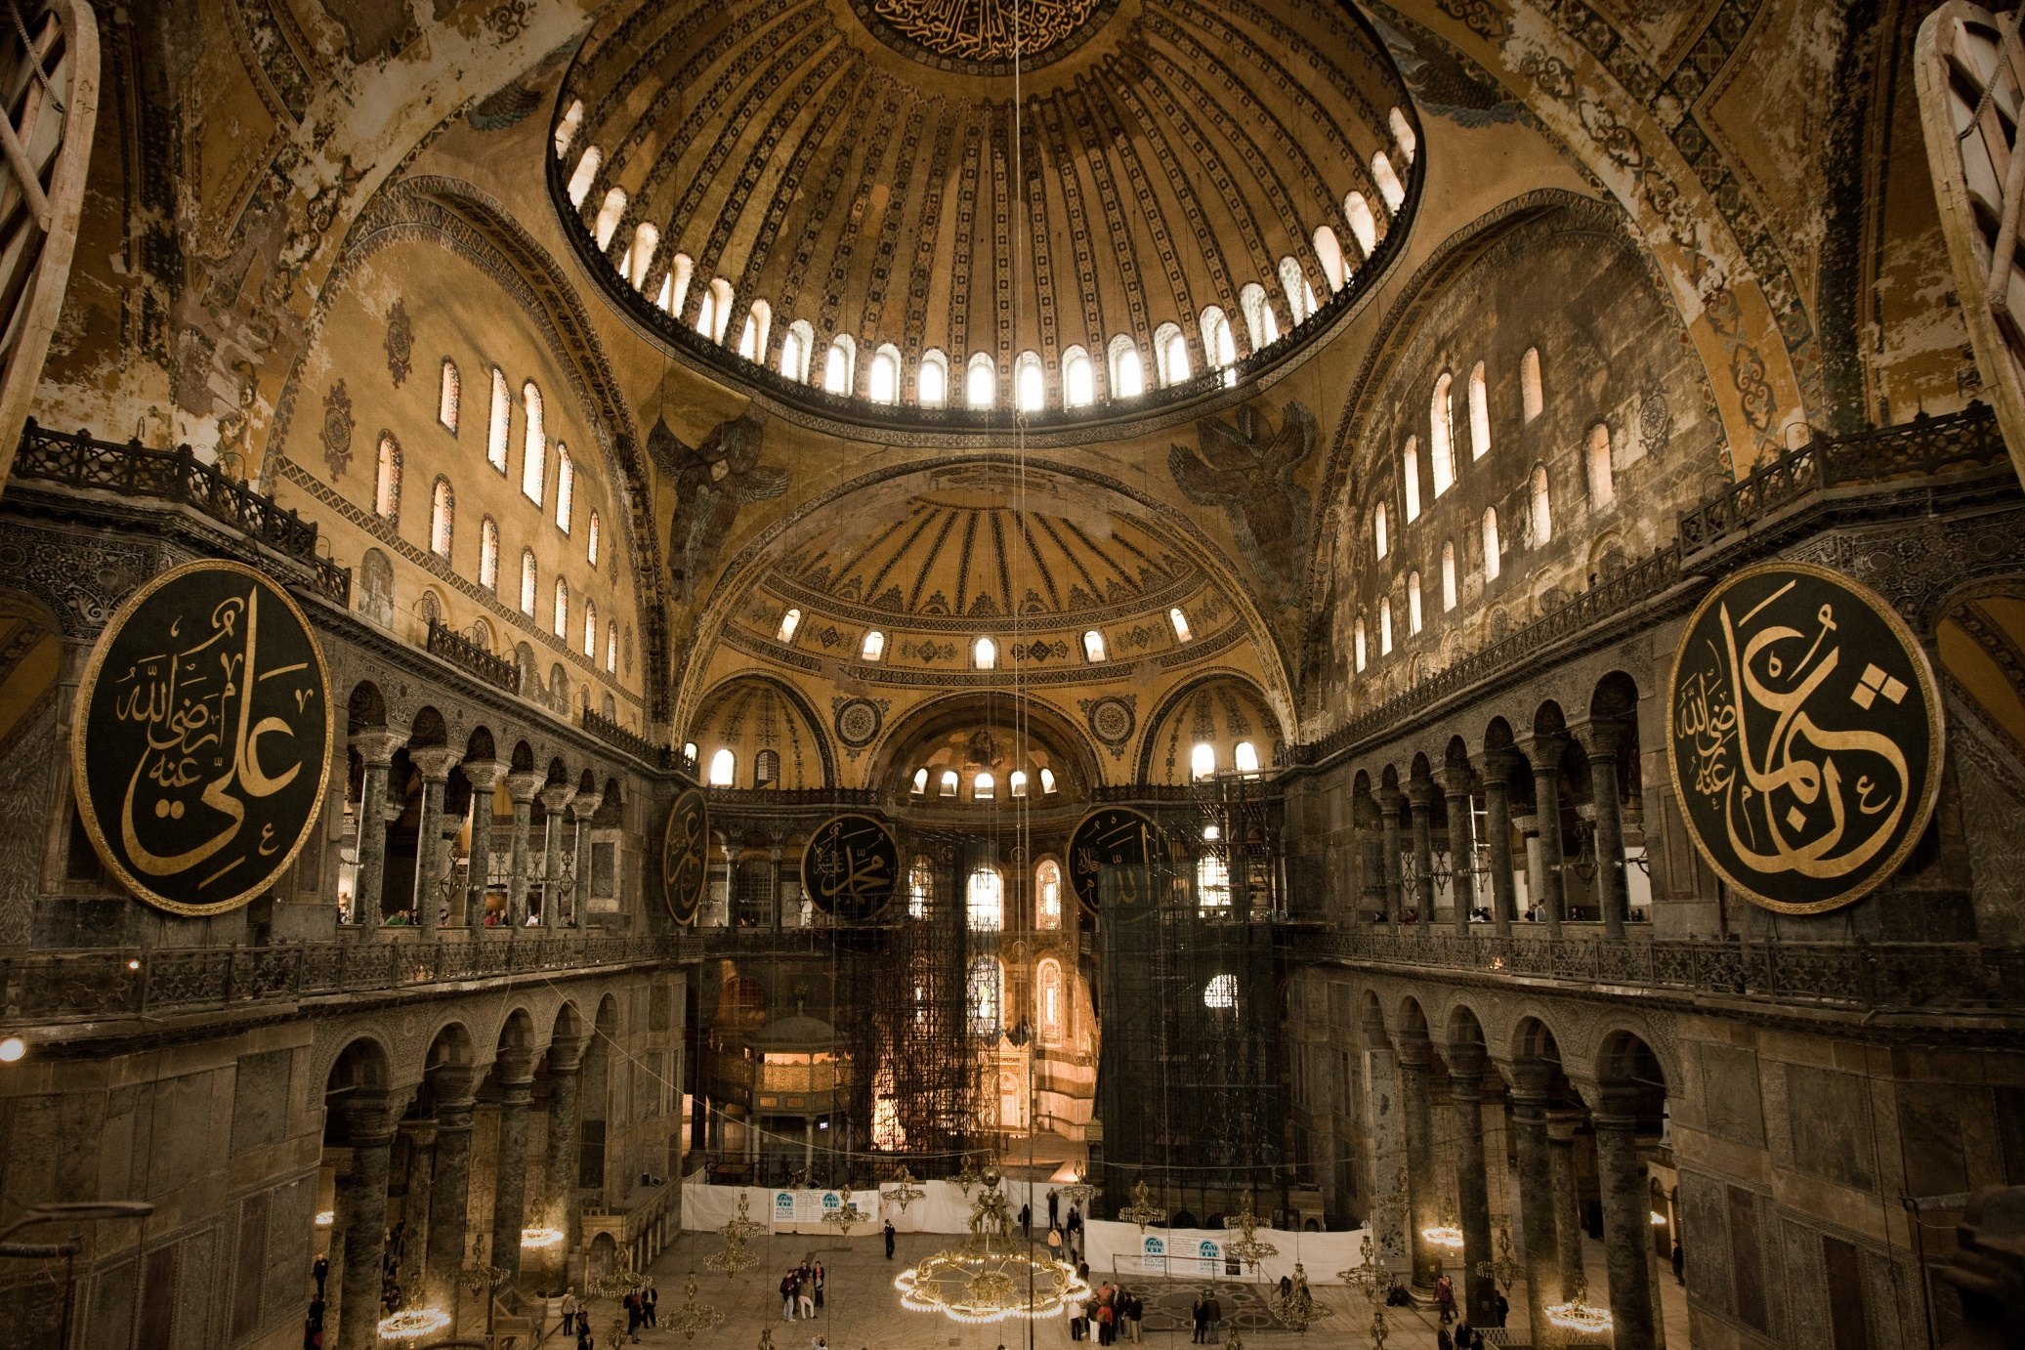
Notes:
Hagia Sophia in Instanbul

Slide 6
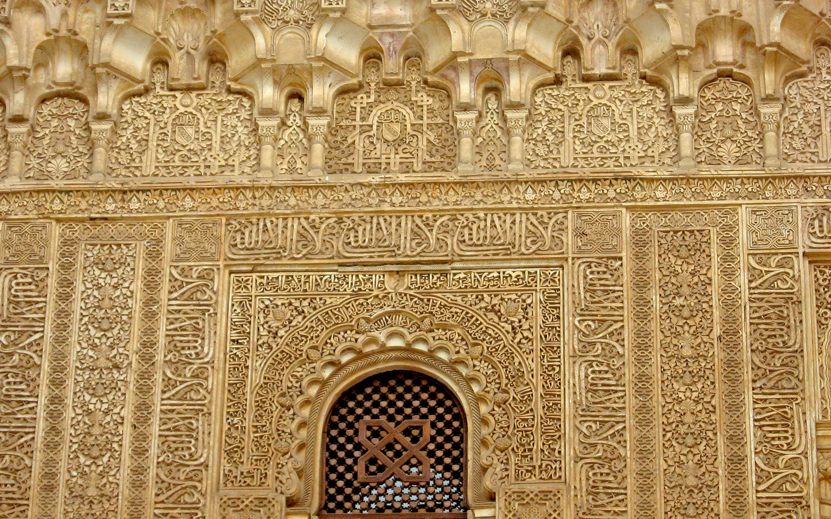
Notes:
Alhambra Palace in Spain

Slide 7
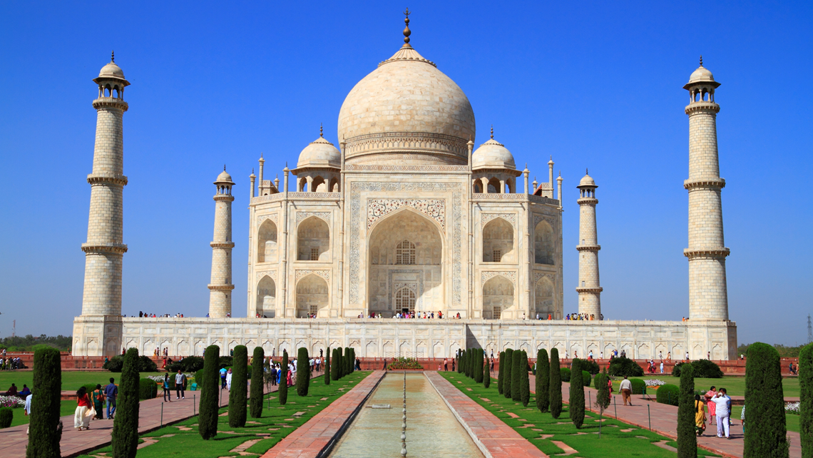

Slide 8
The Ottoman Empire(1453-1918)
Controlled most of ME and part of Europe
Downfall?
1800s=ethnic groups fought for independence.
Failed to modernize
On losing side of WWI
All land except Turkey taken away

Slide 9
Mustafa Kemal Ataturk
1923 he created Republic of Turkey
Modern, European style nation
Reforms
Abolished the fez
Translated Qu’ran into Turkish
Replaced Islamic laws with civil code
Ended Islam as official religion
Ended seclusion of women

