Slide 1
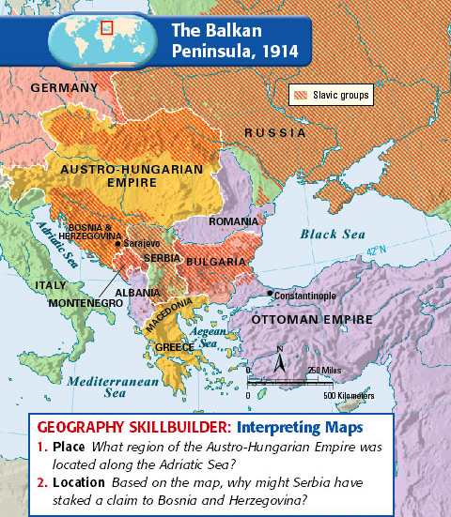
The Balkan Peninsula
“Powder Keg of Europe” bc long history of nationalist uprisings, ethnic clashes
Nationalism strong-each nation wanted to expand its border, especially Serbia
Serbia had large Slavic population: Indo-European ethno-linguistic group
Serbia wanted to absorb all Slavs in Balkan Peninsula, and Russia supported this.

Slide 2
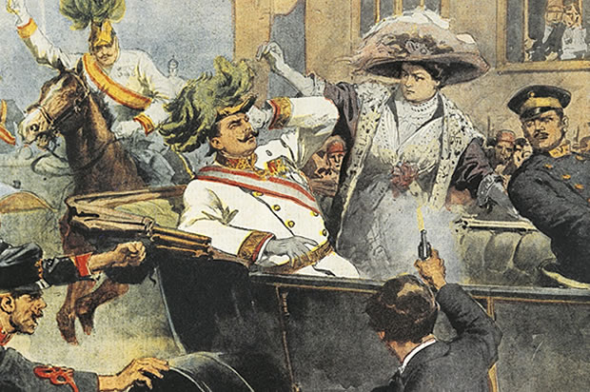
Austria-Hungary(AH) was against this, worried about rebellions
1908 AH annexed Bosnia and Herzegovina, two Balkan areas with large Slavic populations
Serbia outraged! It wanted to control those areas
Which led to….

