Slide 1
Top 20 Psychologists

Slide 2
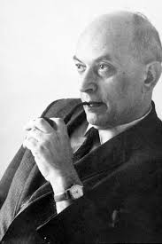
Solomon Asch
Conformity
Line experiment
Group size and unanimity

Slide 3
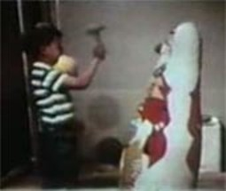
Albert Bandura
Social (Observational) Learning
Bobo Doll
Aggression
Reciprocal Determinism

Slide 4
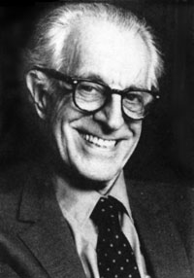
Albert Ellis
Rational-Emotive Therapy
Homework
Cognitive-Behavioral

Slide 5
Erik Erikson

Slide 6
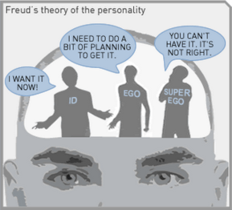
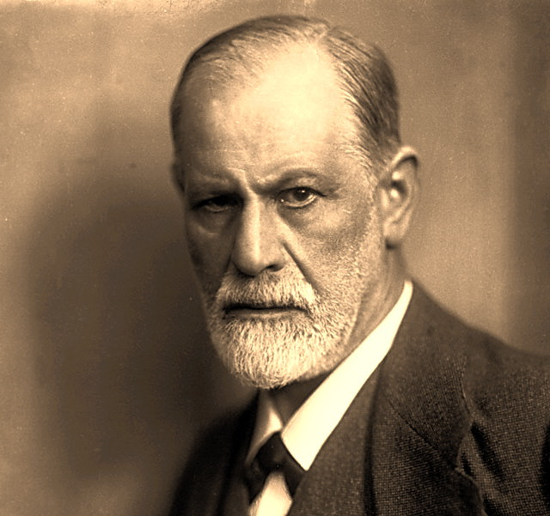
Sigmund Freud
Psychoanalysis
Id, Ego, Superego
Defense Mechanisms
Conscious, Preconscious, Unconscious
Fixation. Oedipus and Electra Complex
Psychosexual Stages
Oral, Anal, Phallic, Latency, Genital

Slide 7
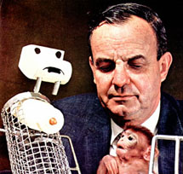
Harry Harlow
Contact Comfort > Food
Monkeys

Slide 8
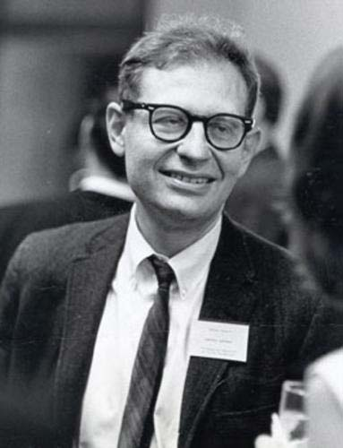
Lawrence Kohlberg
Theory of Moral Development
Preconventional
Conventional
Postconventional
Gilligan critical

Slide 9
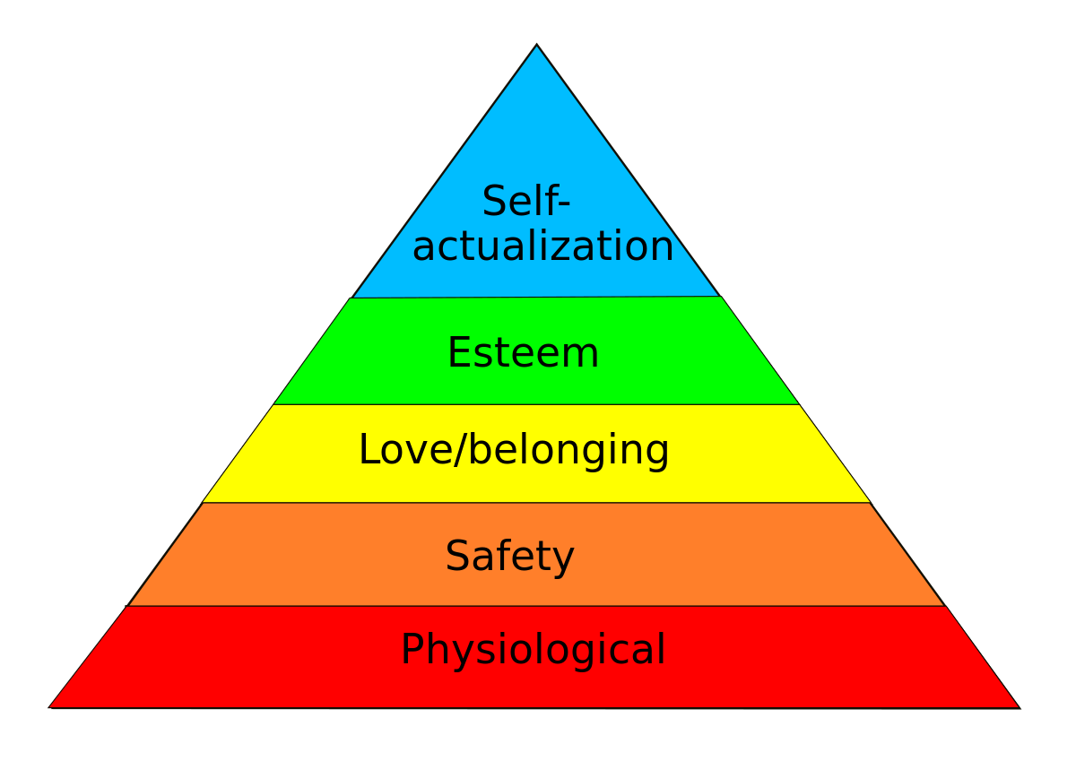
Abraham Maslow
Hierarchy of Needs
Humanist

Slide 10
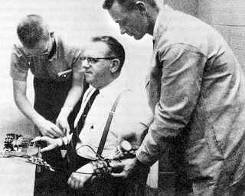
Stanley Milgram
Obedience Study
Shocks
Unethical

Slide 11
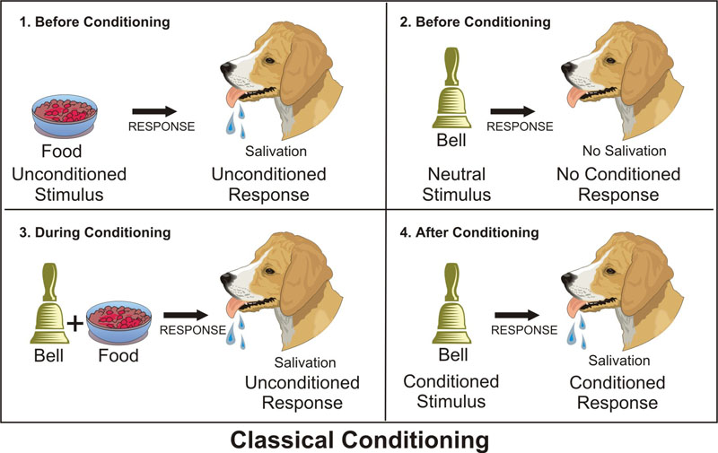
Ivan Pavlov
Classical Conditioning
Dogs

Slide 12
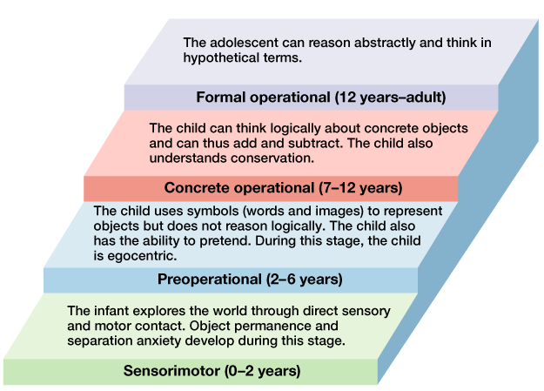
Jean Piaget
Theory of Cognitive Development (Silly Pigs Can Fly)
Schema, Assimilation, Accommodation

Slide 13
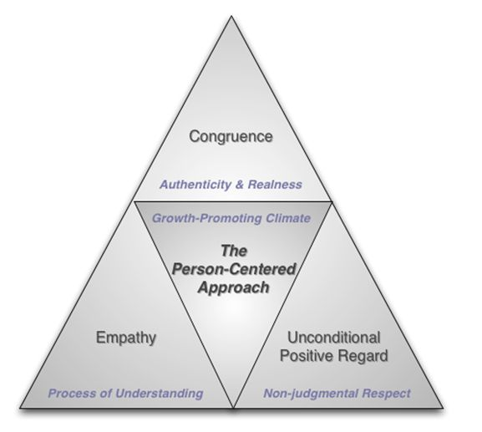
Carl Rogers
Humanist
Client-Centered Therapy
Active listening
Self-actualize

Slide 14
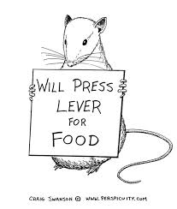
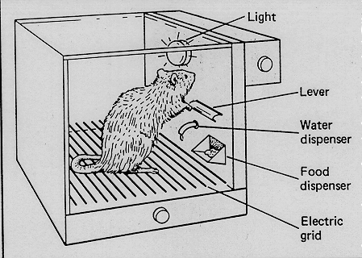
B.F. Skinner
Operant Conditioning
Rewards
Punishments

Slide 15
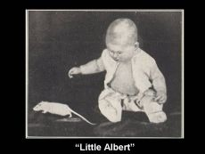
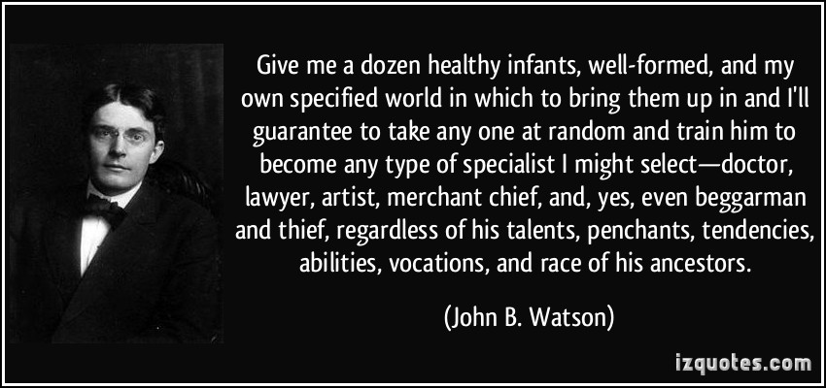
John Watson
Father of Behaviorism
Little Albert

Slide 16
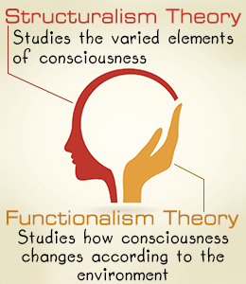
Wilhelm Wundt
Father of Modern Psychology
Structuralism

Slide 17
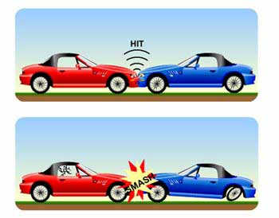
Elizabeth Loftus
Misinformation Effect

Slide 18
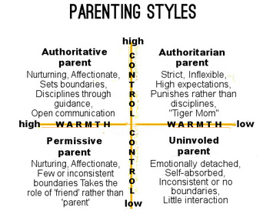
Diana Baumrind
Parenting Styles
Authoritarian, Authoritative, Permissive, Dismissive

Slide 19
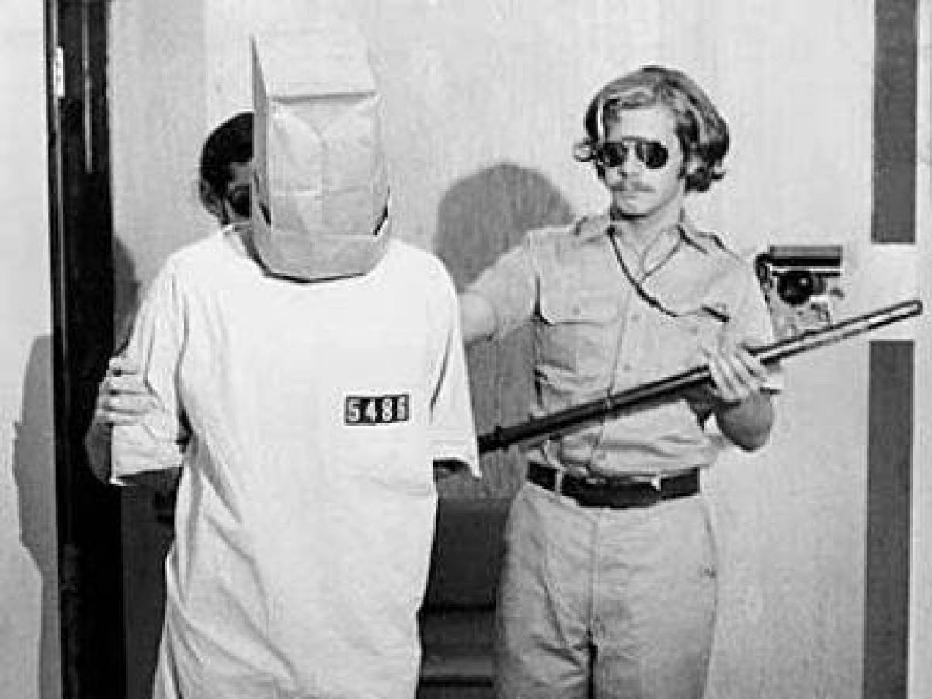
Phillip Zimbardo
Stanford Prison Experiment
Unethical
Power of Roles

Slide 20
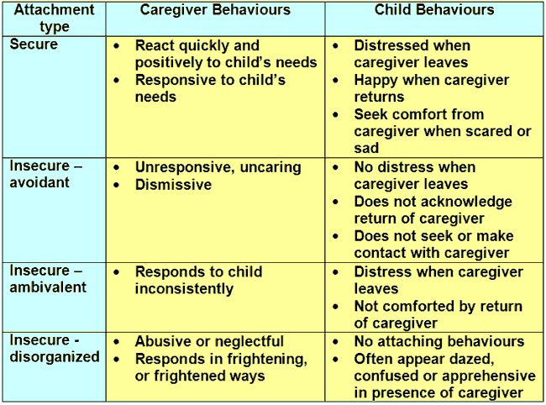
Mary Ainsworth
“Strange Situation”
Attachment Styles
Secure, Avoidant, Anxious/Ambivalent

Slide 21
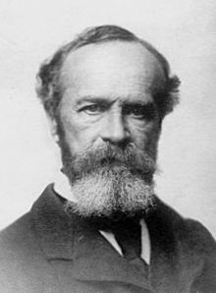
William James
Father of American Psychology
Functionalism

